Slide 1
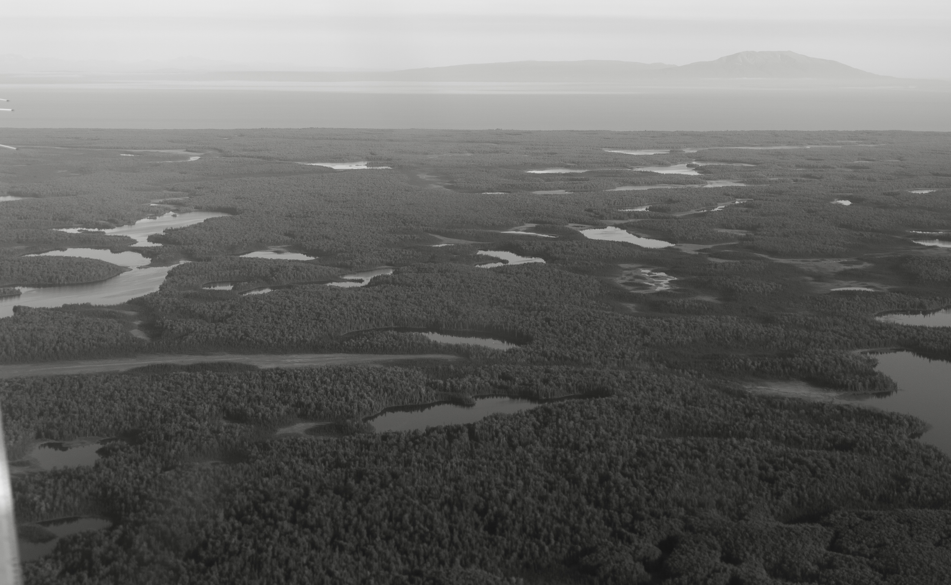
Spatiotemporal trends in salmon metapopulation contributions to portfolio effects in Western Alaska
Ben Makhlouf

Slide 2
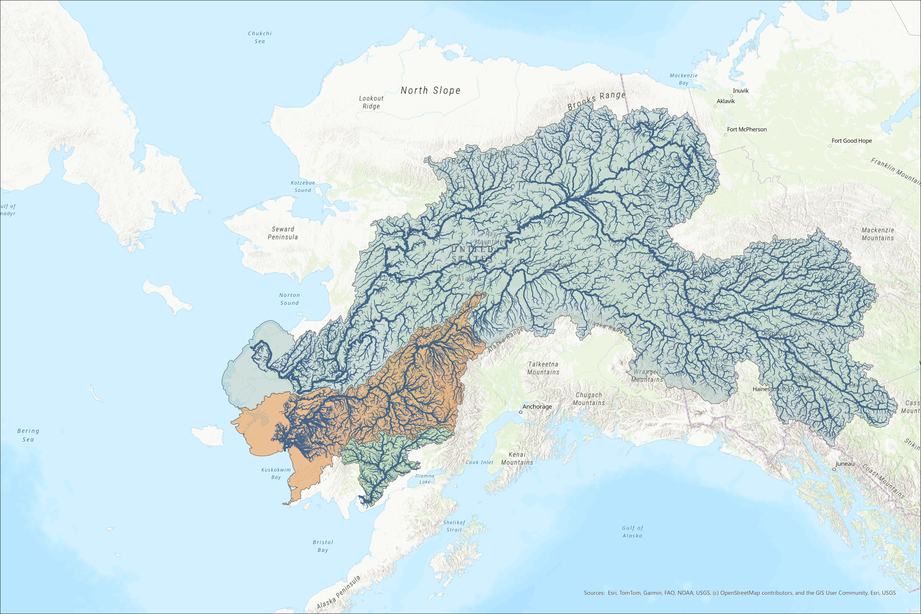


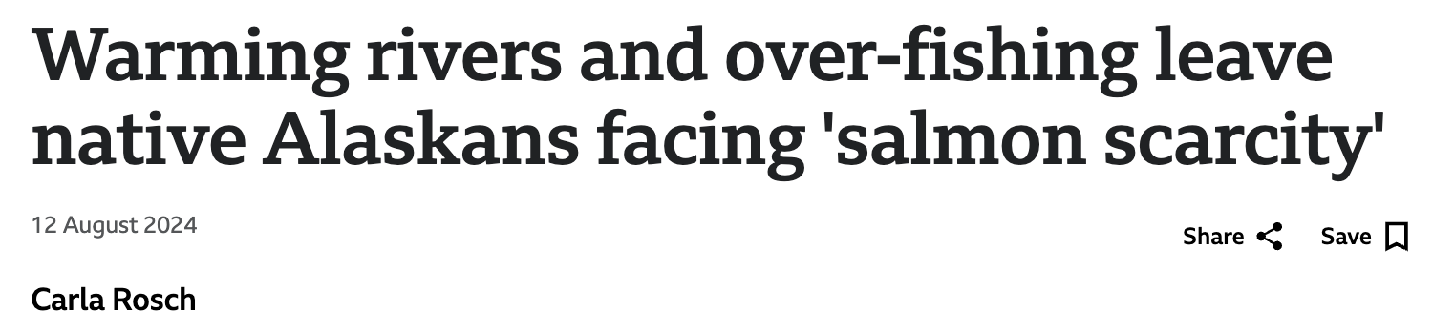

Slide 3
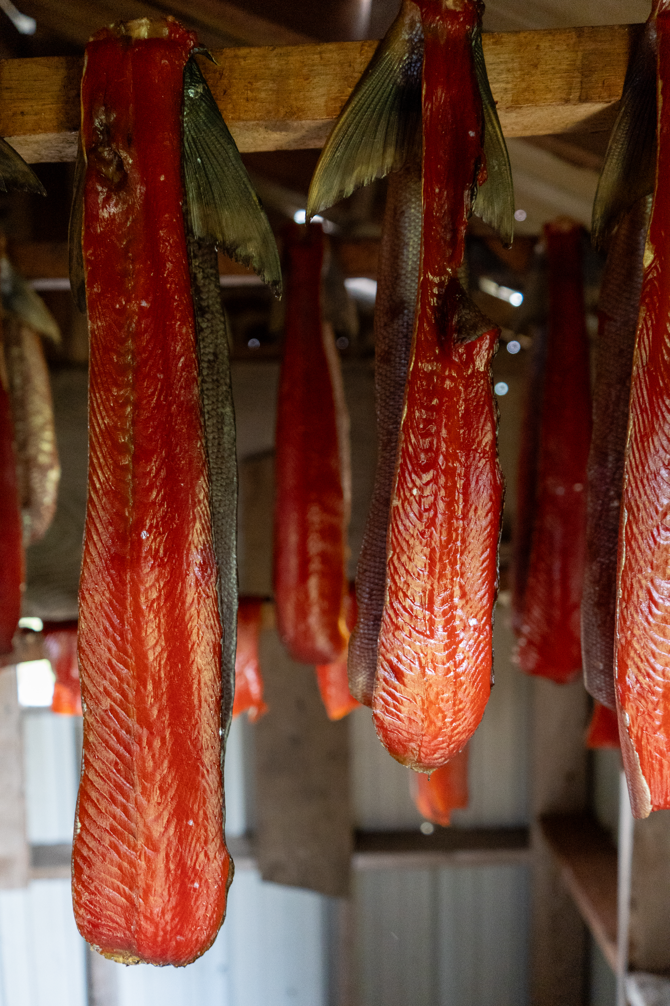
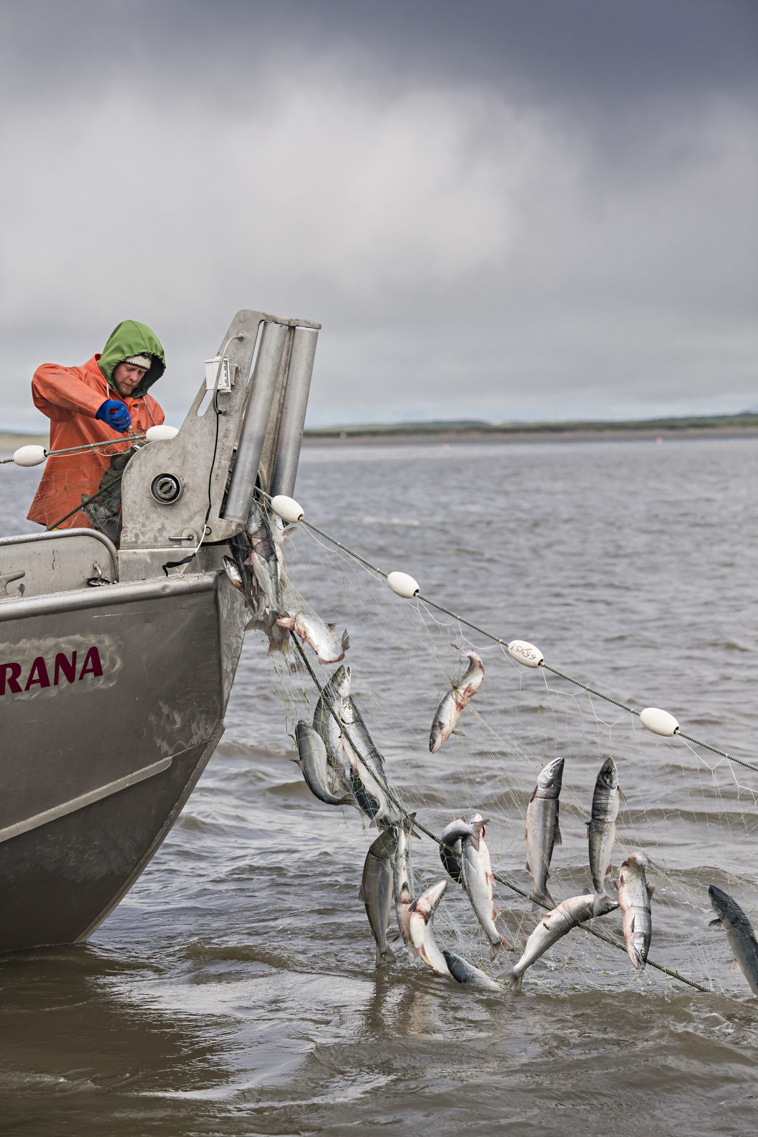
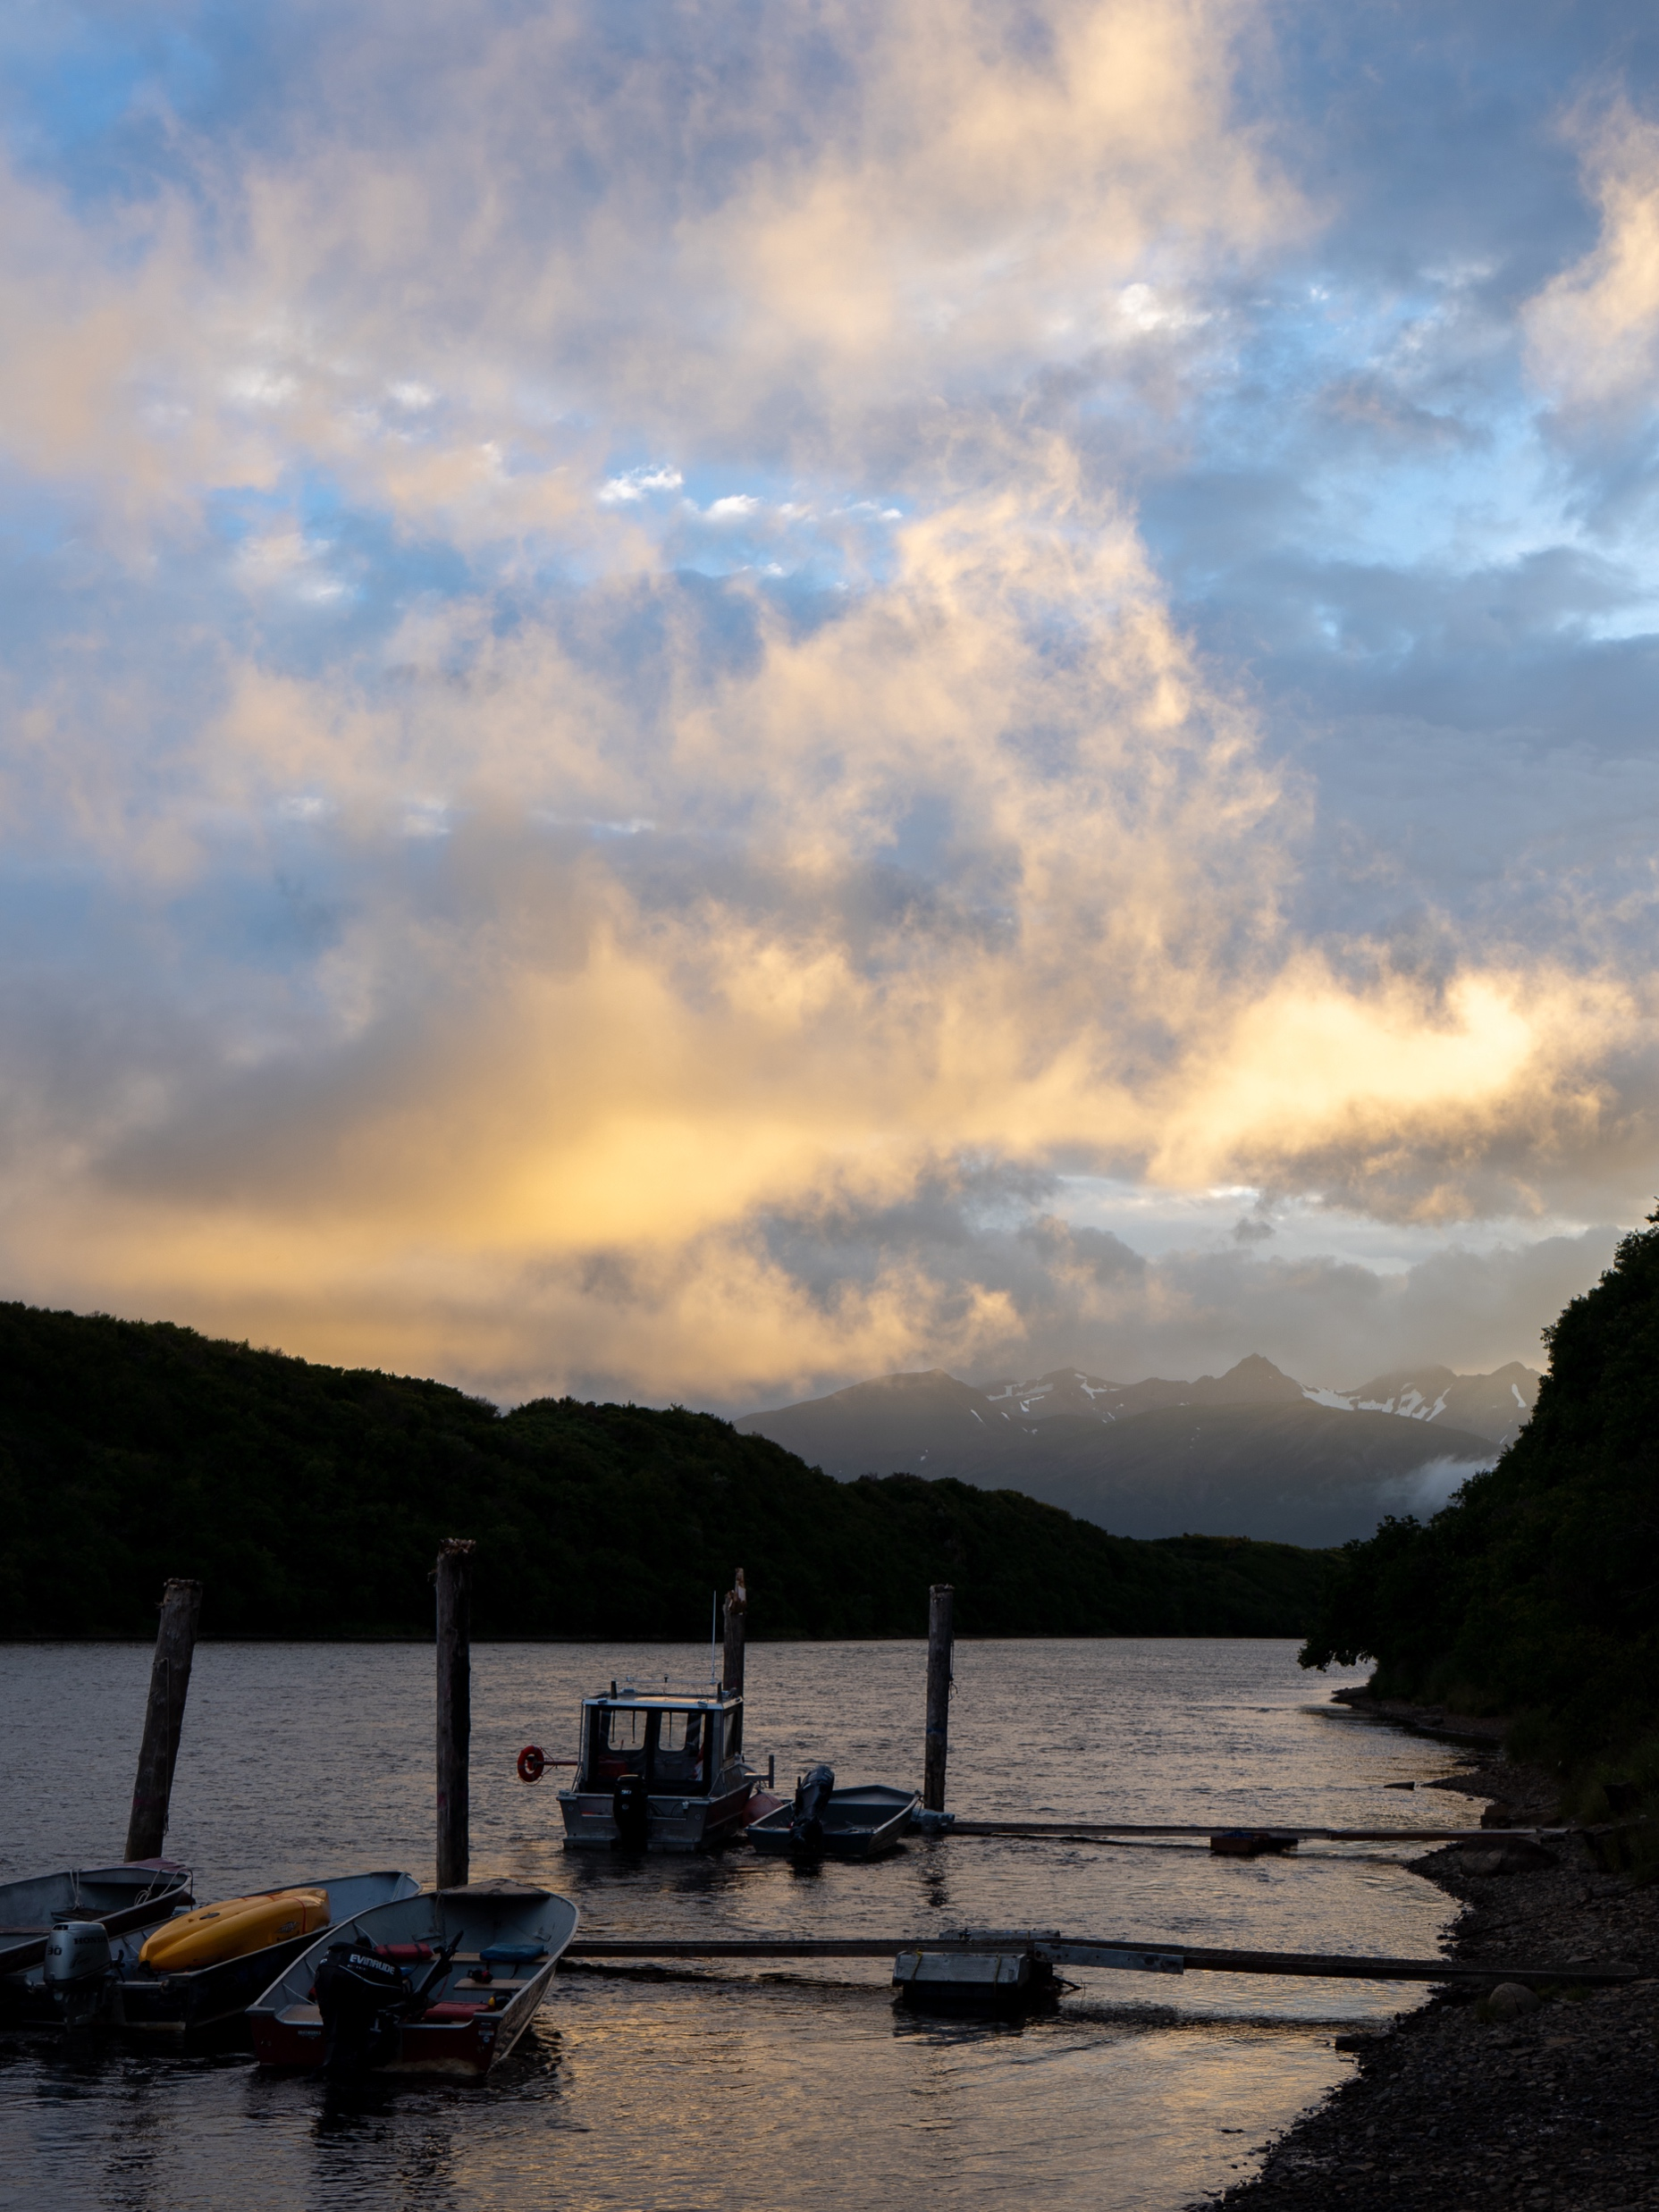
This puts managers in a bind... - Allow harvest - protect fish (rebuild stock) - Make sure this never happens again (climate adaptation and resilliance)

Slide 4
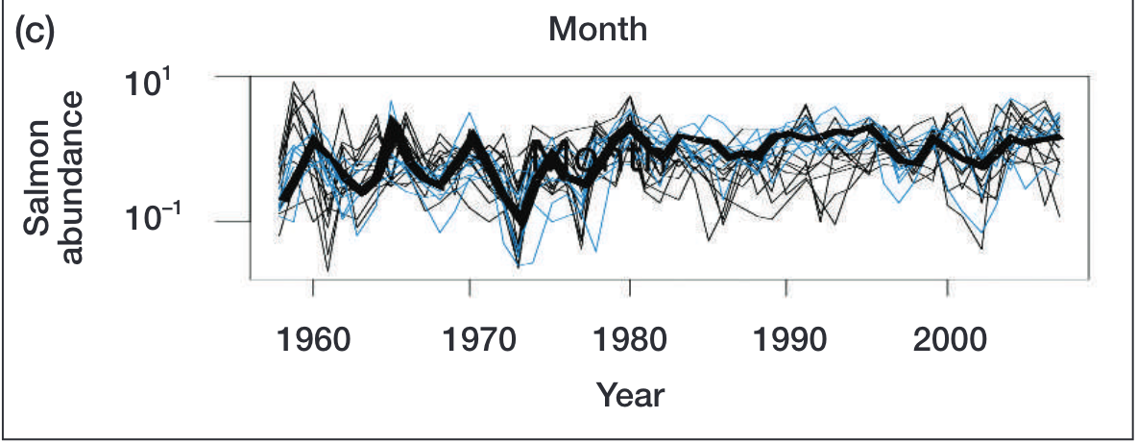
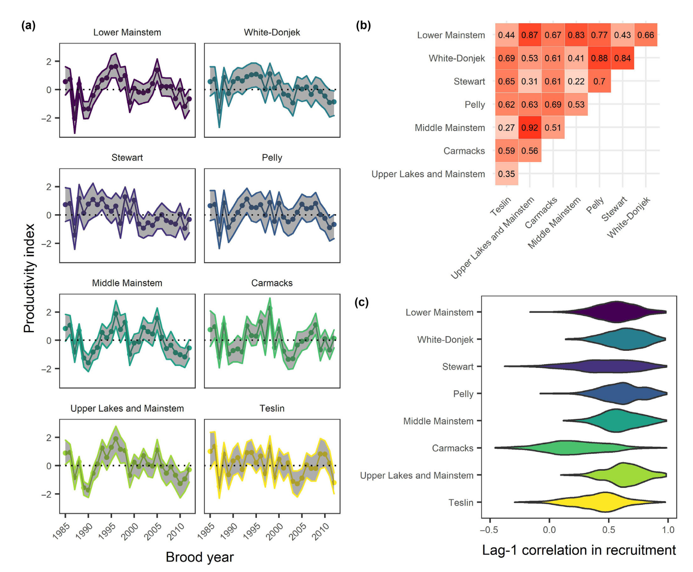
The ”Portfolio effect”
Natural variability (within and among systems, species, etc) “diversifies” assets similar to financial markets, dampens variation for the population
Weak or negative covariance among salmon metapopulation timing/production over space/time contributes towards population stability/resilliance to climate change

Slide 5
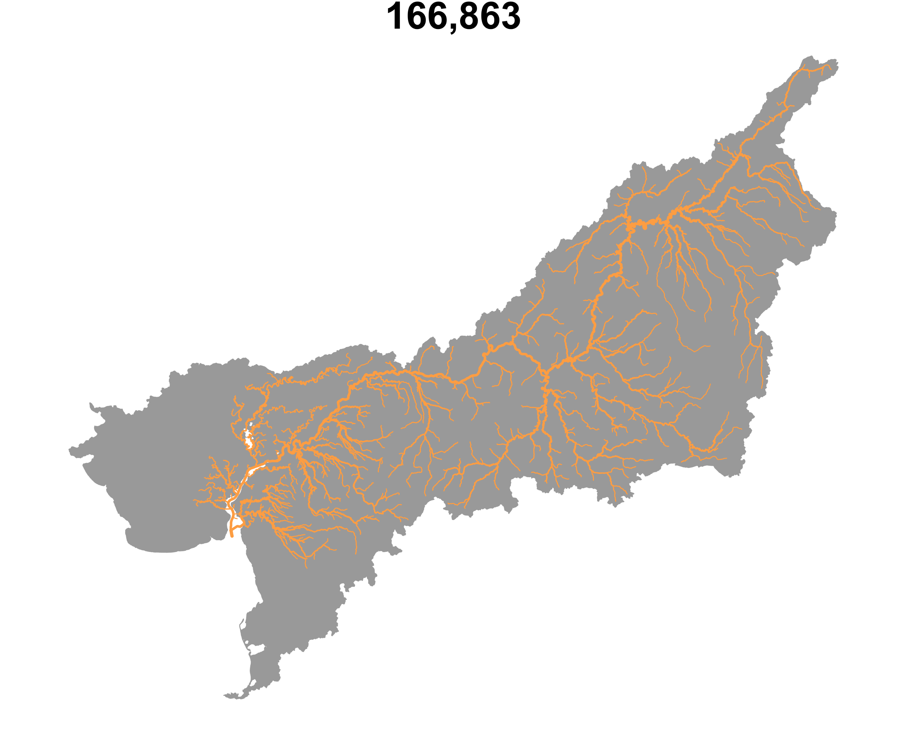

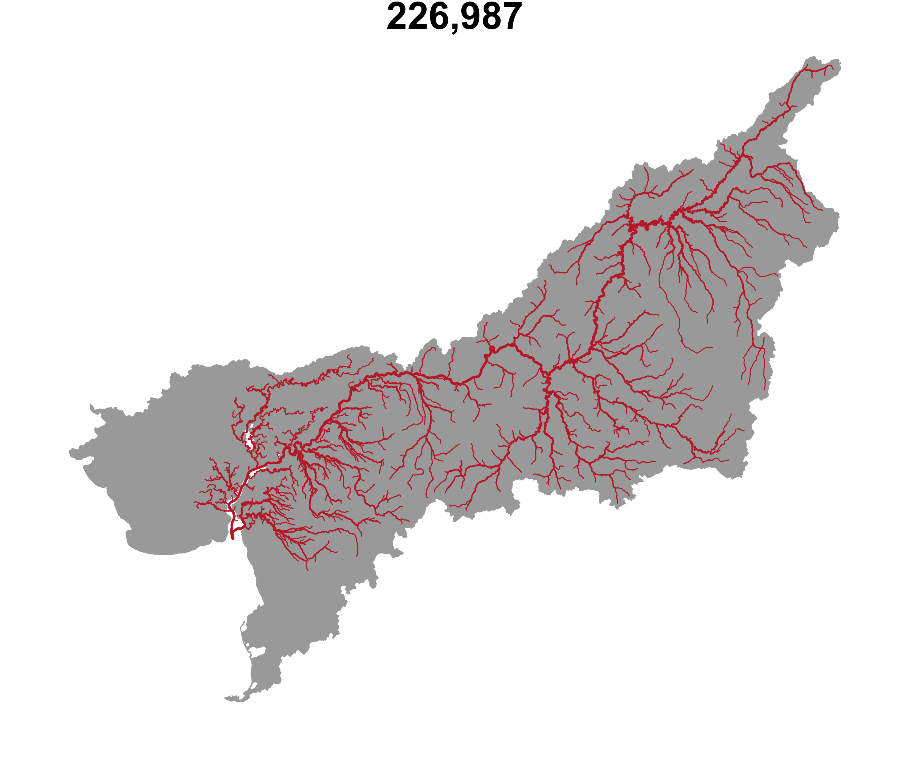
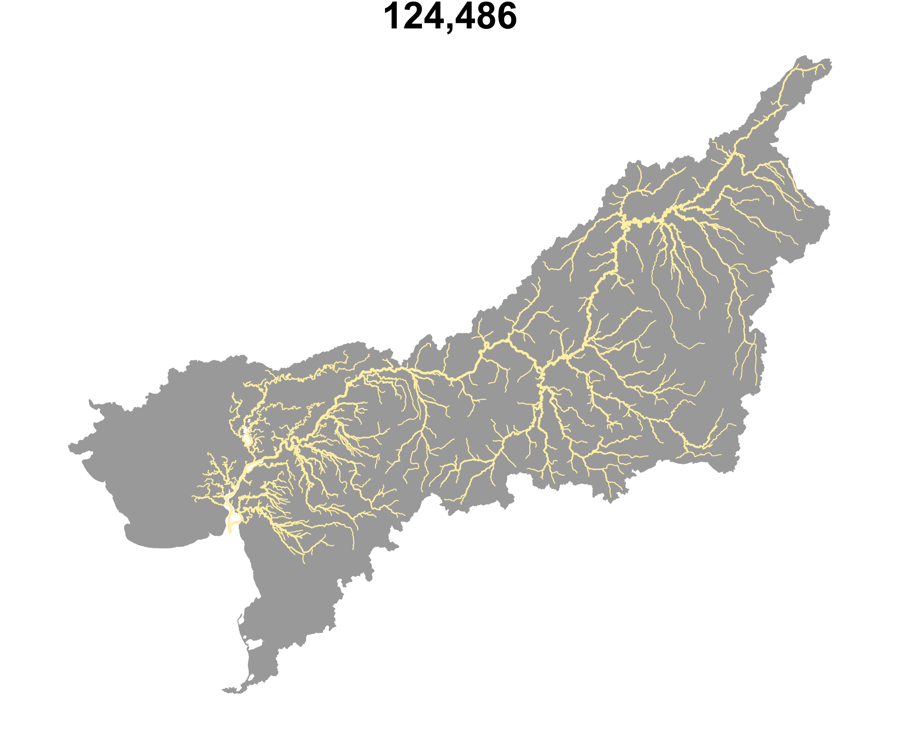

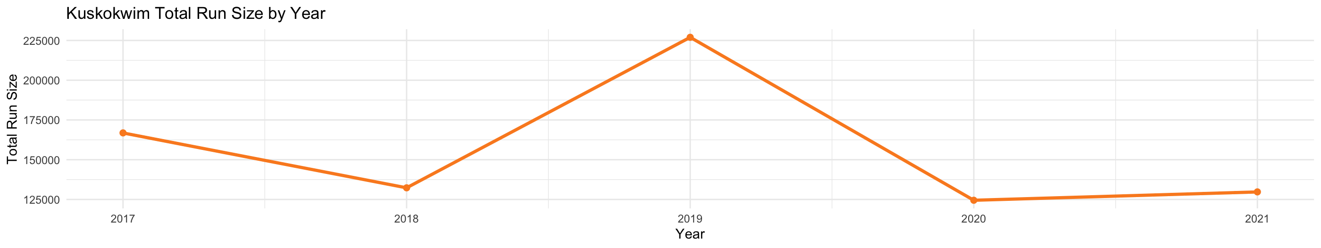
Assessing ecosystem health needs to incorporate the health of each component, not overall abundance

Slide 6

Currently: very little understanding of spatial distribution/timing in the Kuskokwim

Slide 7
The remedy; front end closures until June 11th (~ 10 days into the season).
Boosts overall numbers, but what stock(s) does it protect?

Slide 8
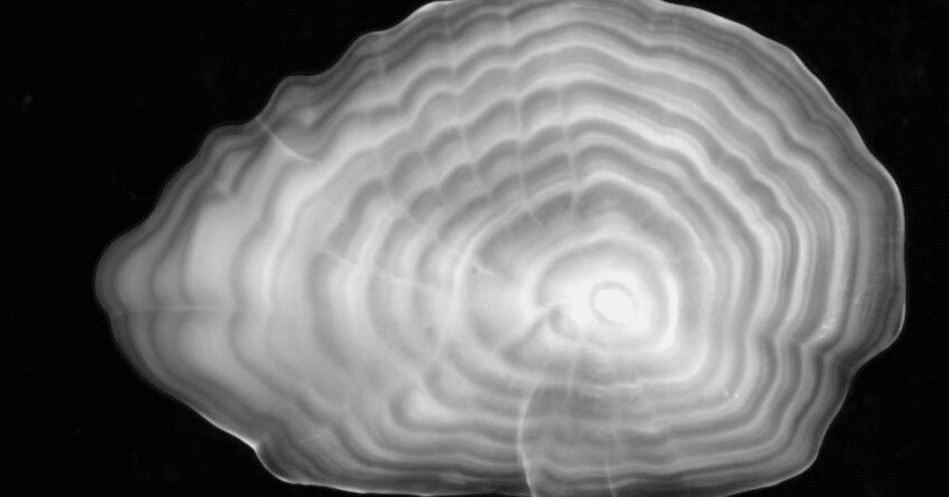
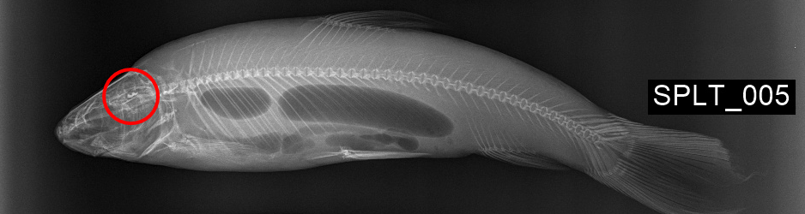
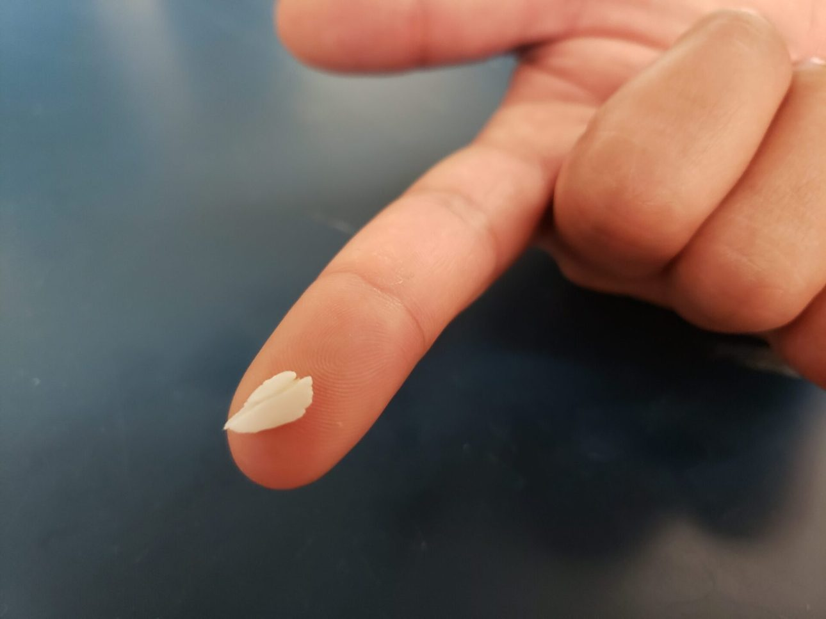
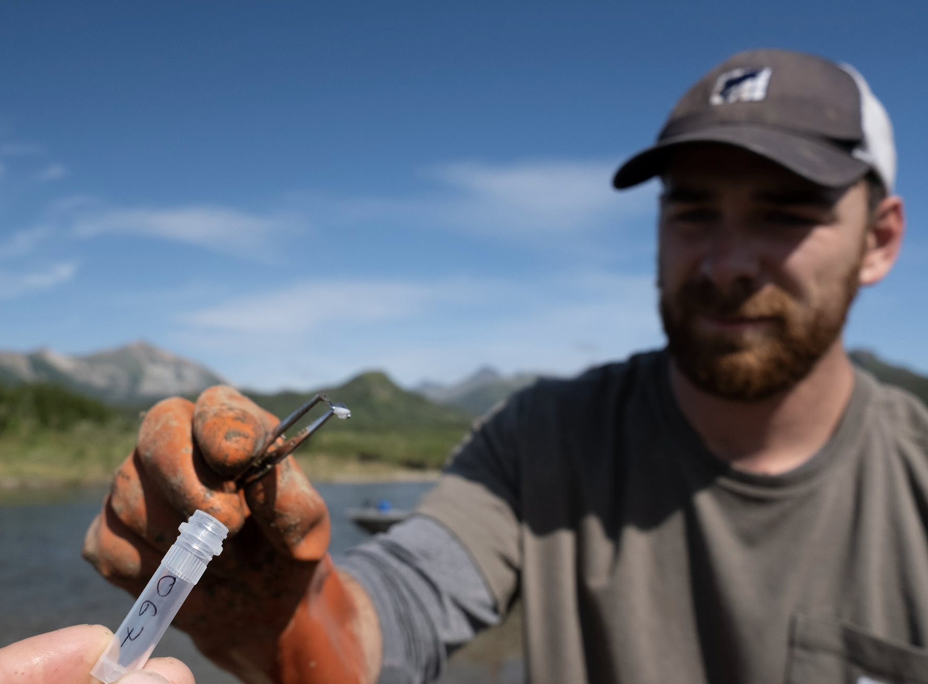
Otoliths
; a “time capsule”
Notes:
... so we use otoliths...

Slide 9
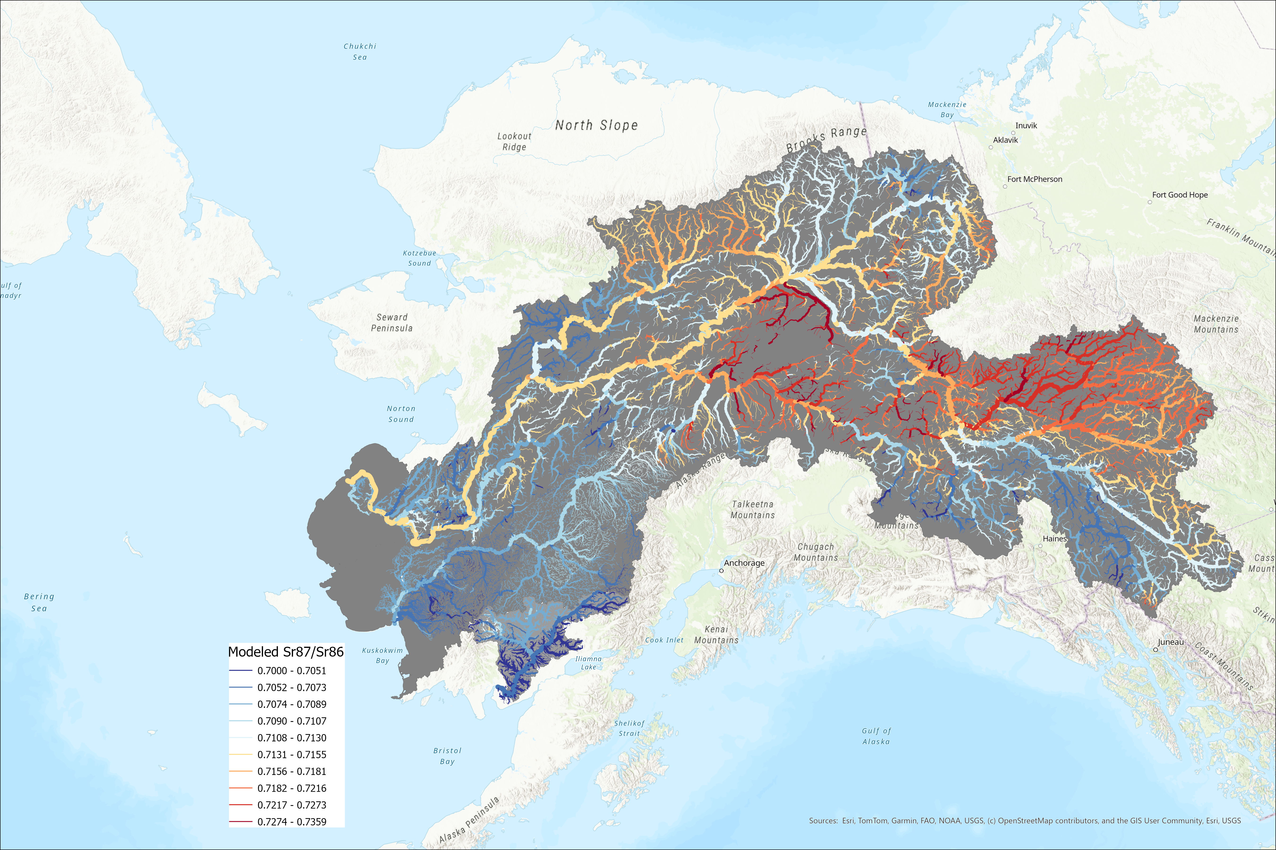
Strontium
Sr⁸⁷/Sr⁸⁶
Notes:
Precise estimate

Slide 10

5 years of otolith samples,
Currently almost no understanding of spatial distribution/timing in the Kuskokwim
Kuskokwim

Slide 11
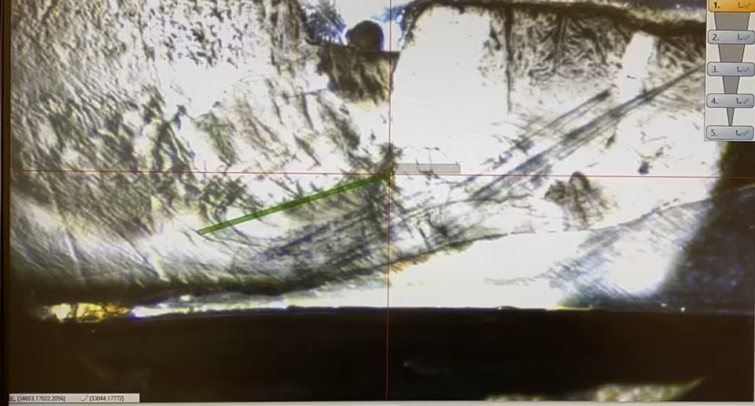
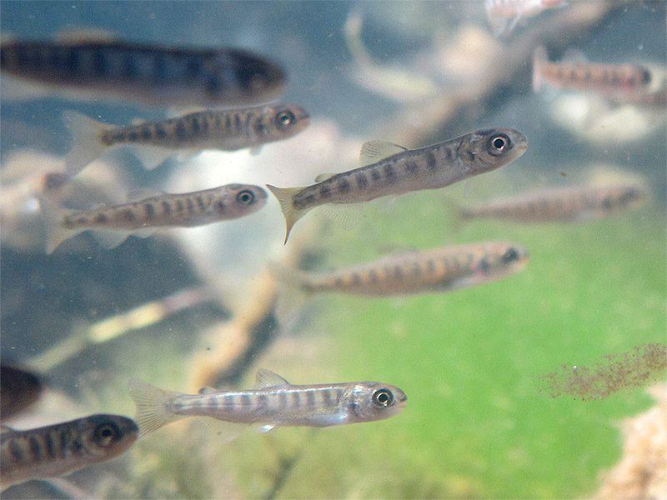
Notes:
Stress why people USUALLY look at just one

Slide 12
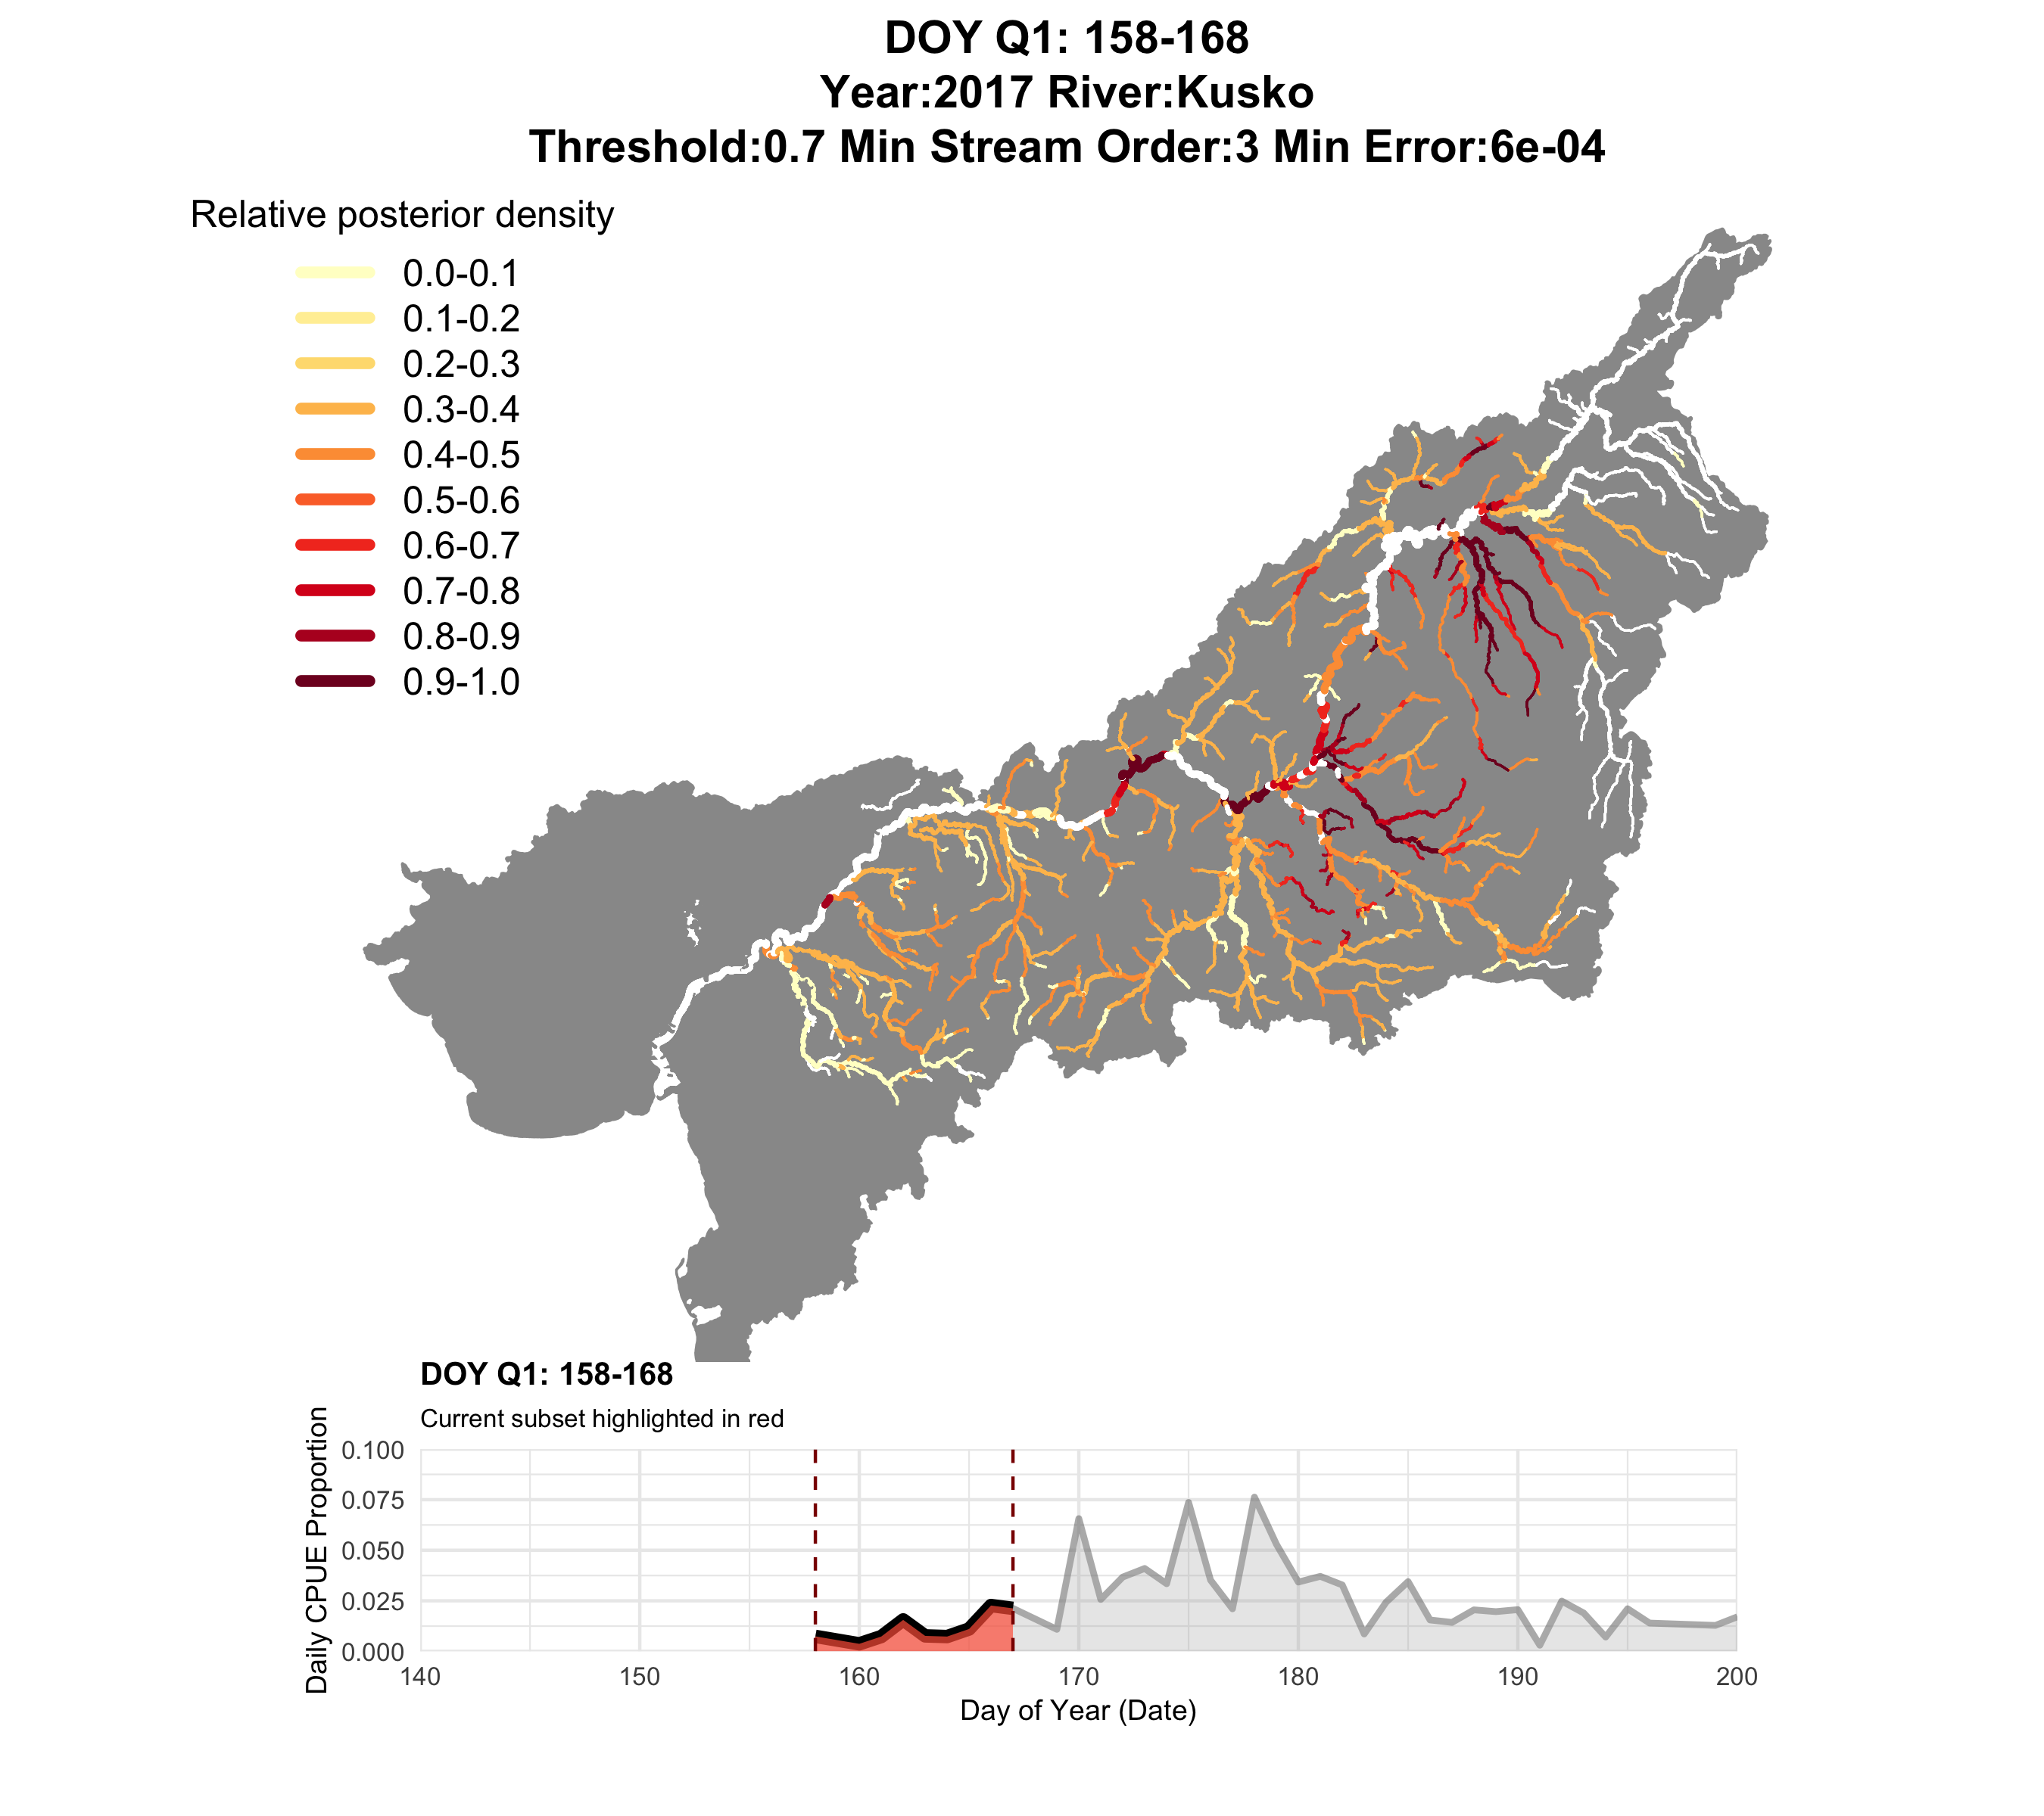
2017
Q1 (closure window)

Slide 13
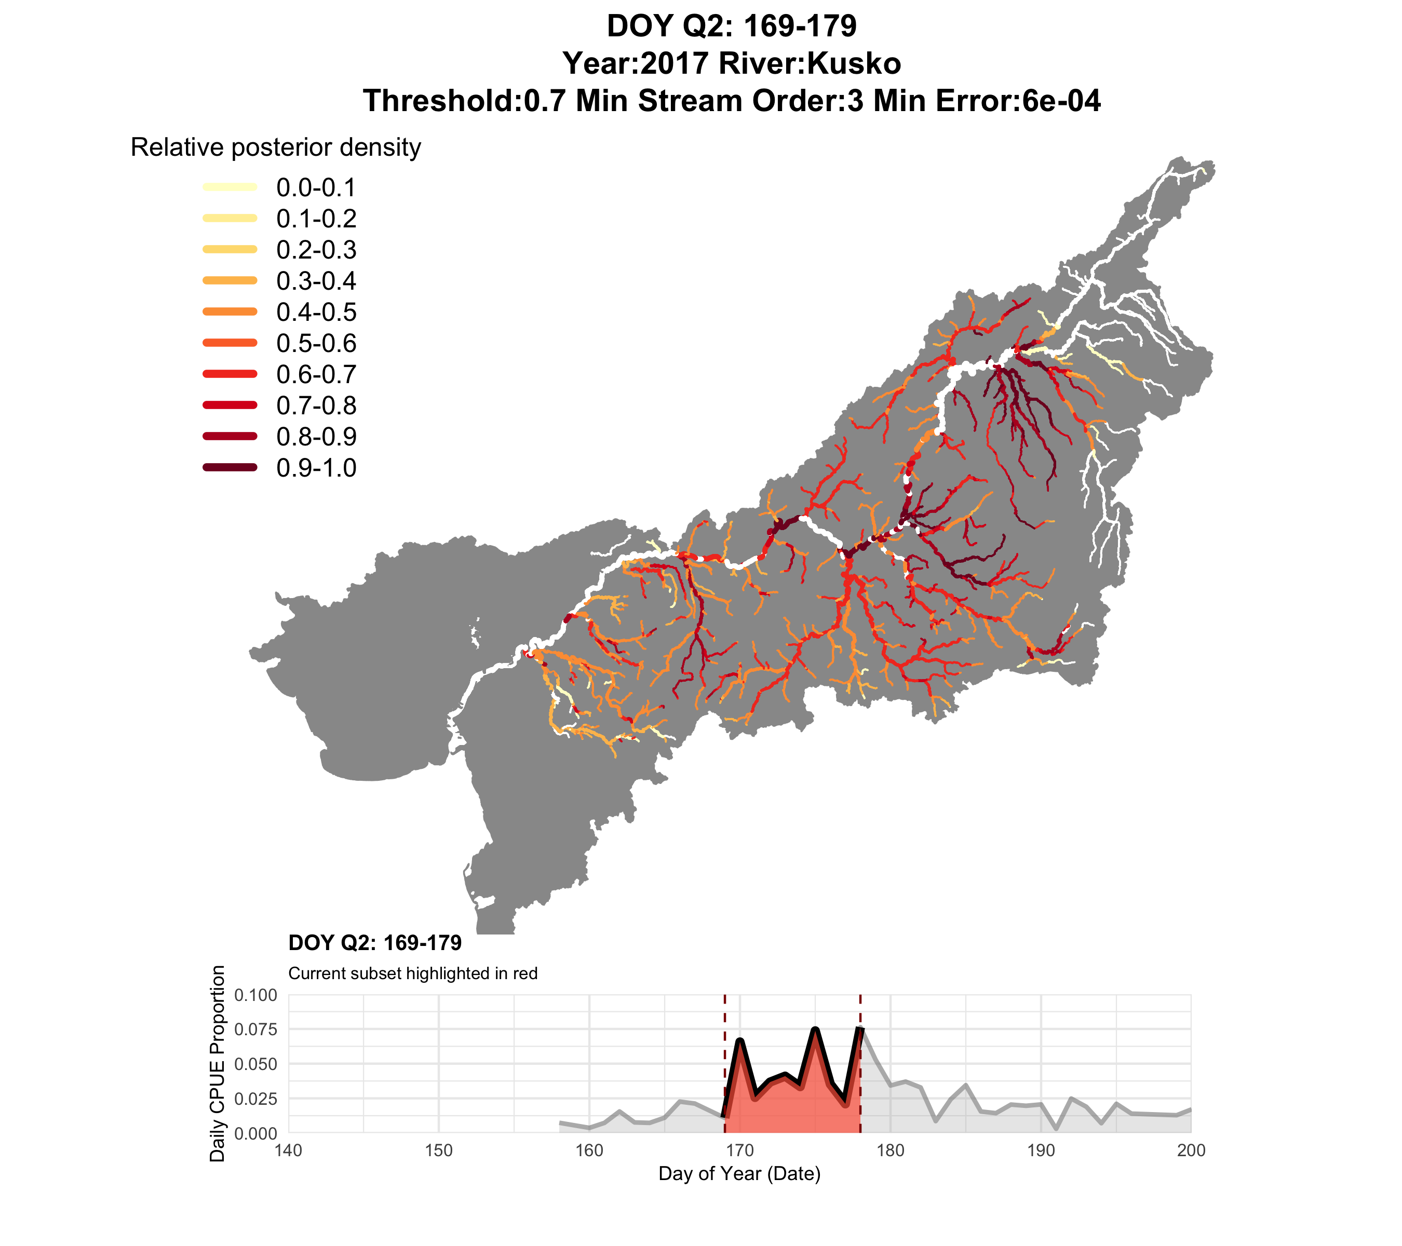
2017
Q2

Slide 14
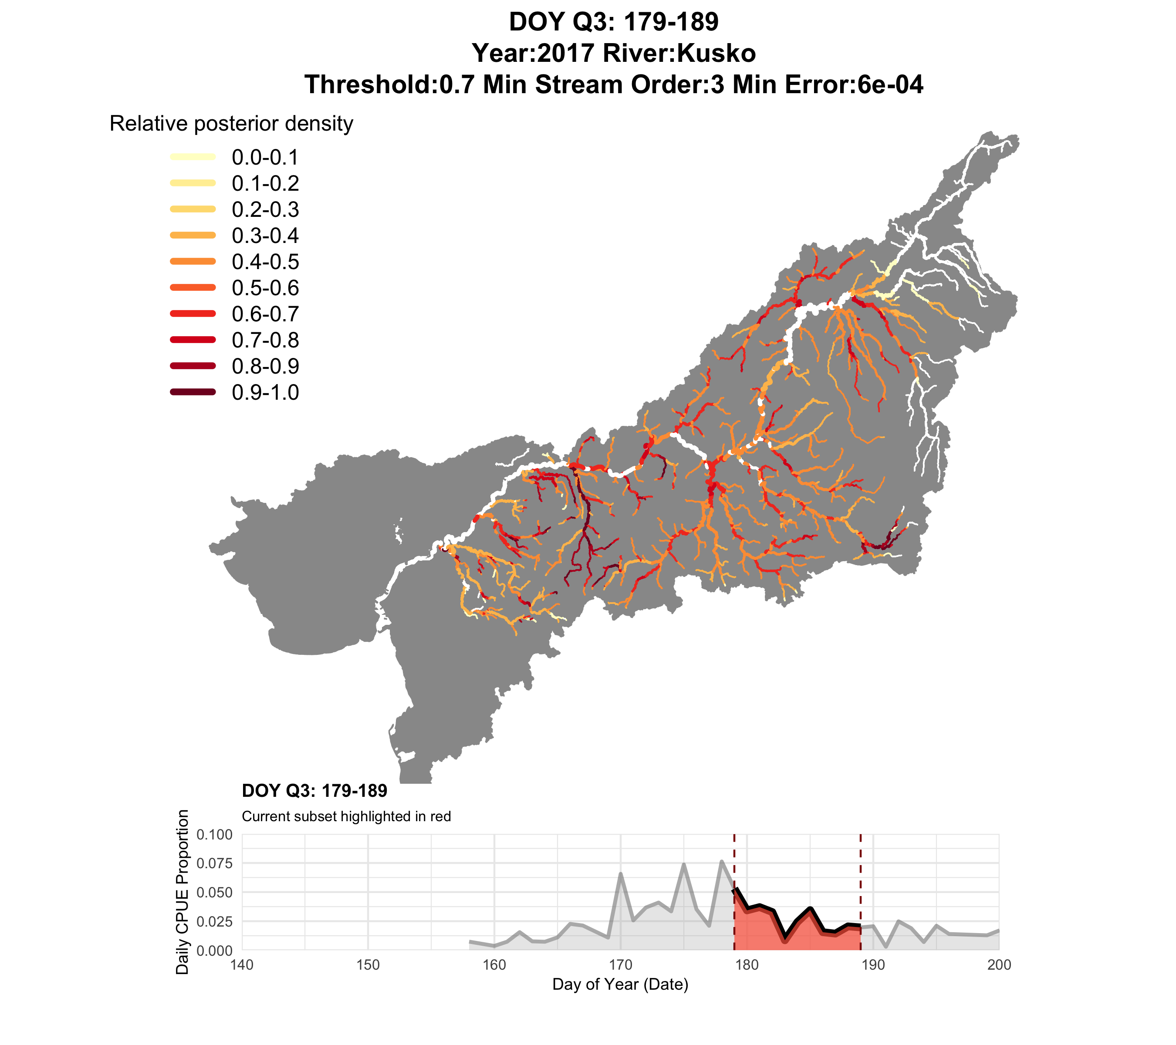
2017
Q3

Slide 15
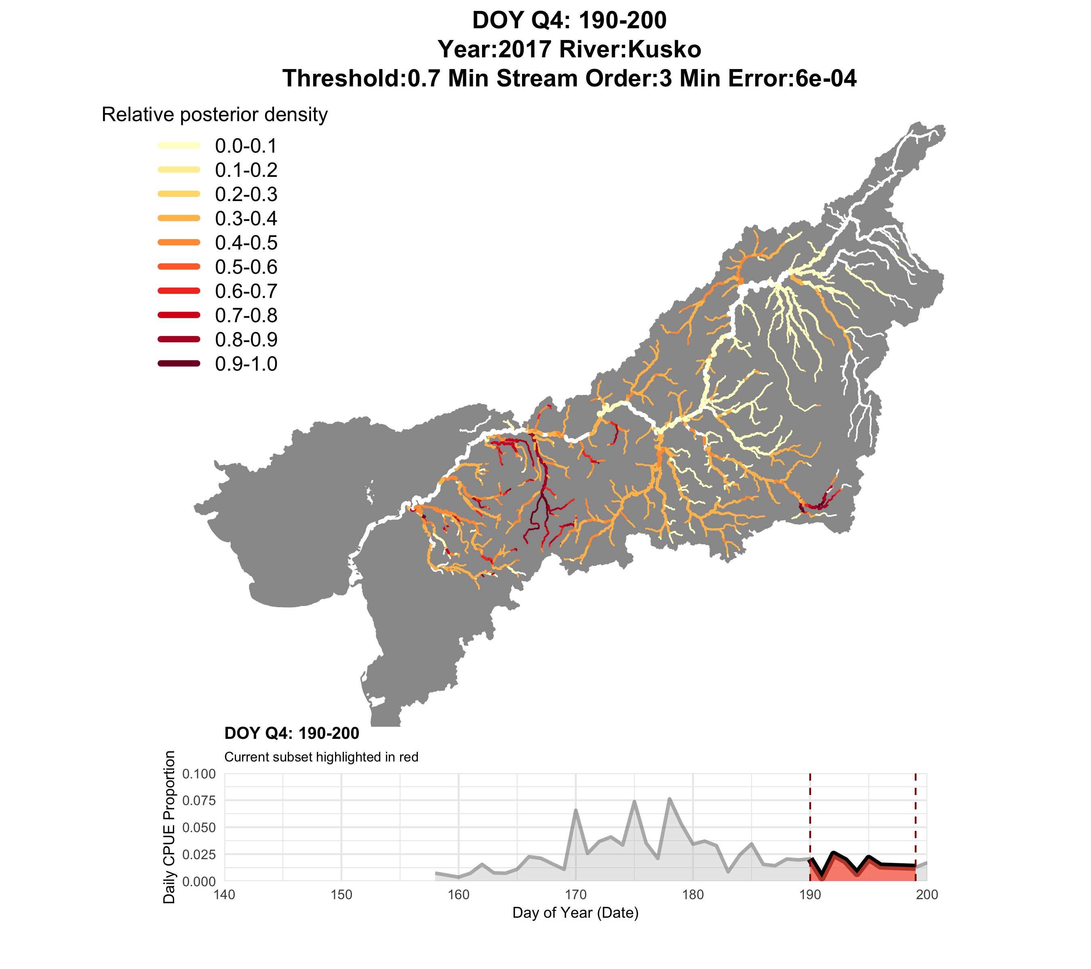
2017
Q4

Slide 16

2018
Q1 (closure window)

Slide 17
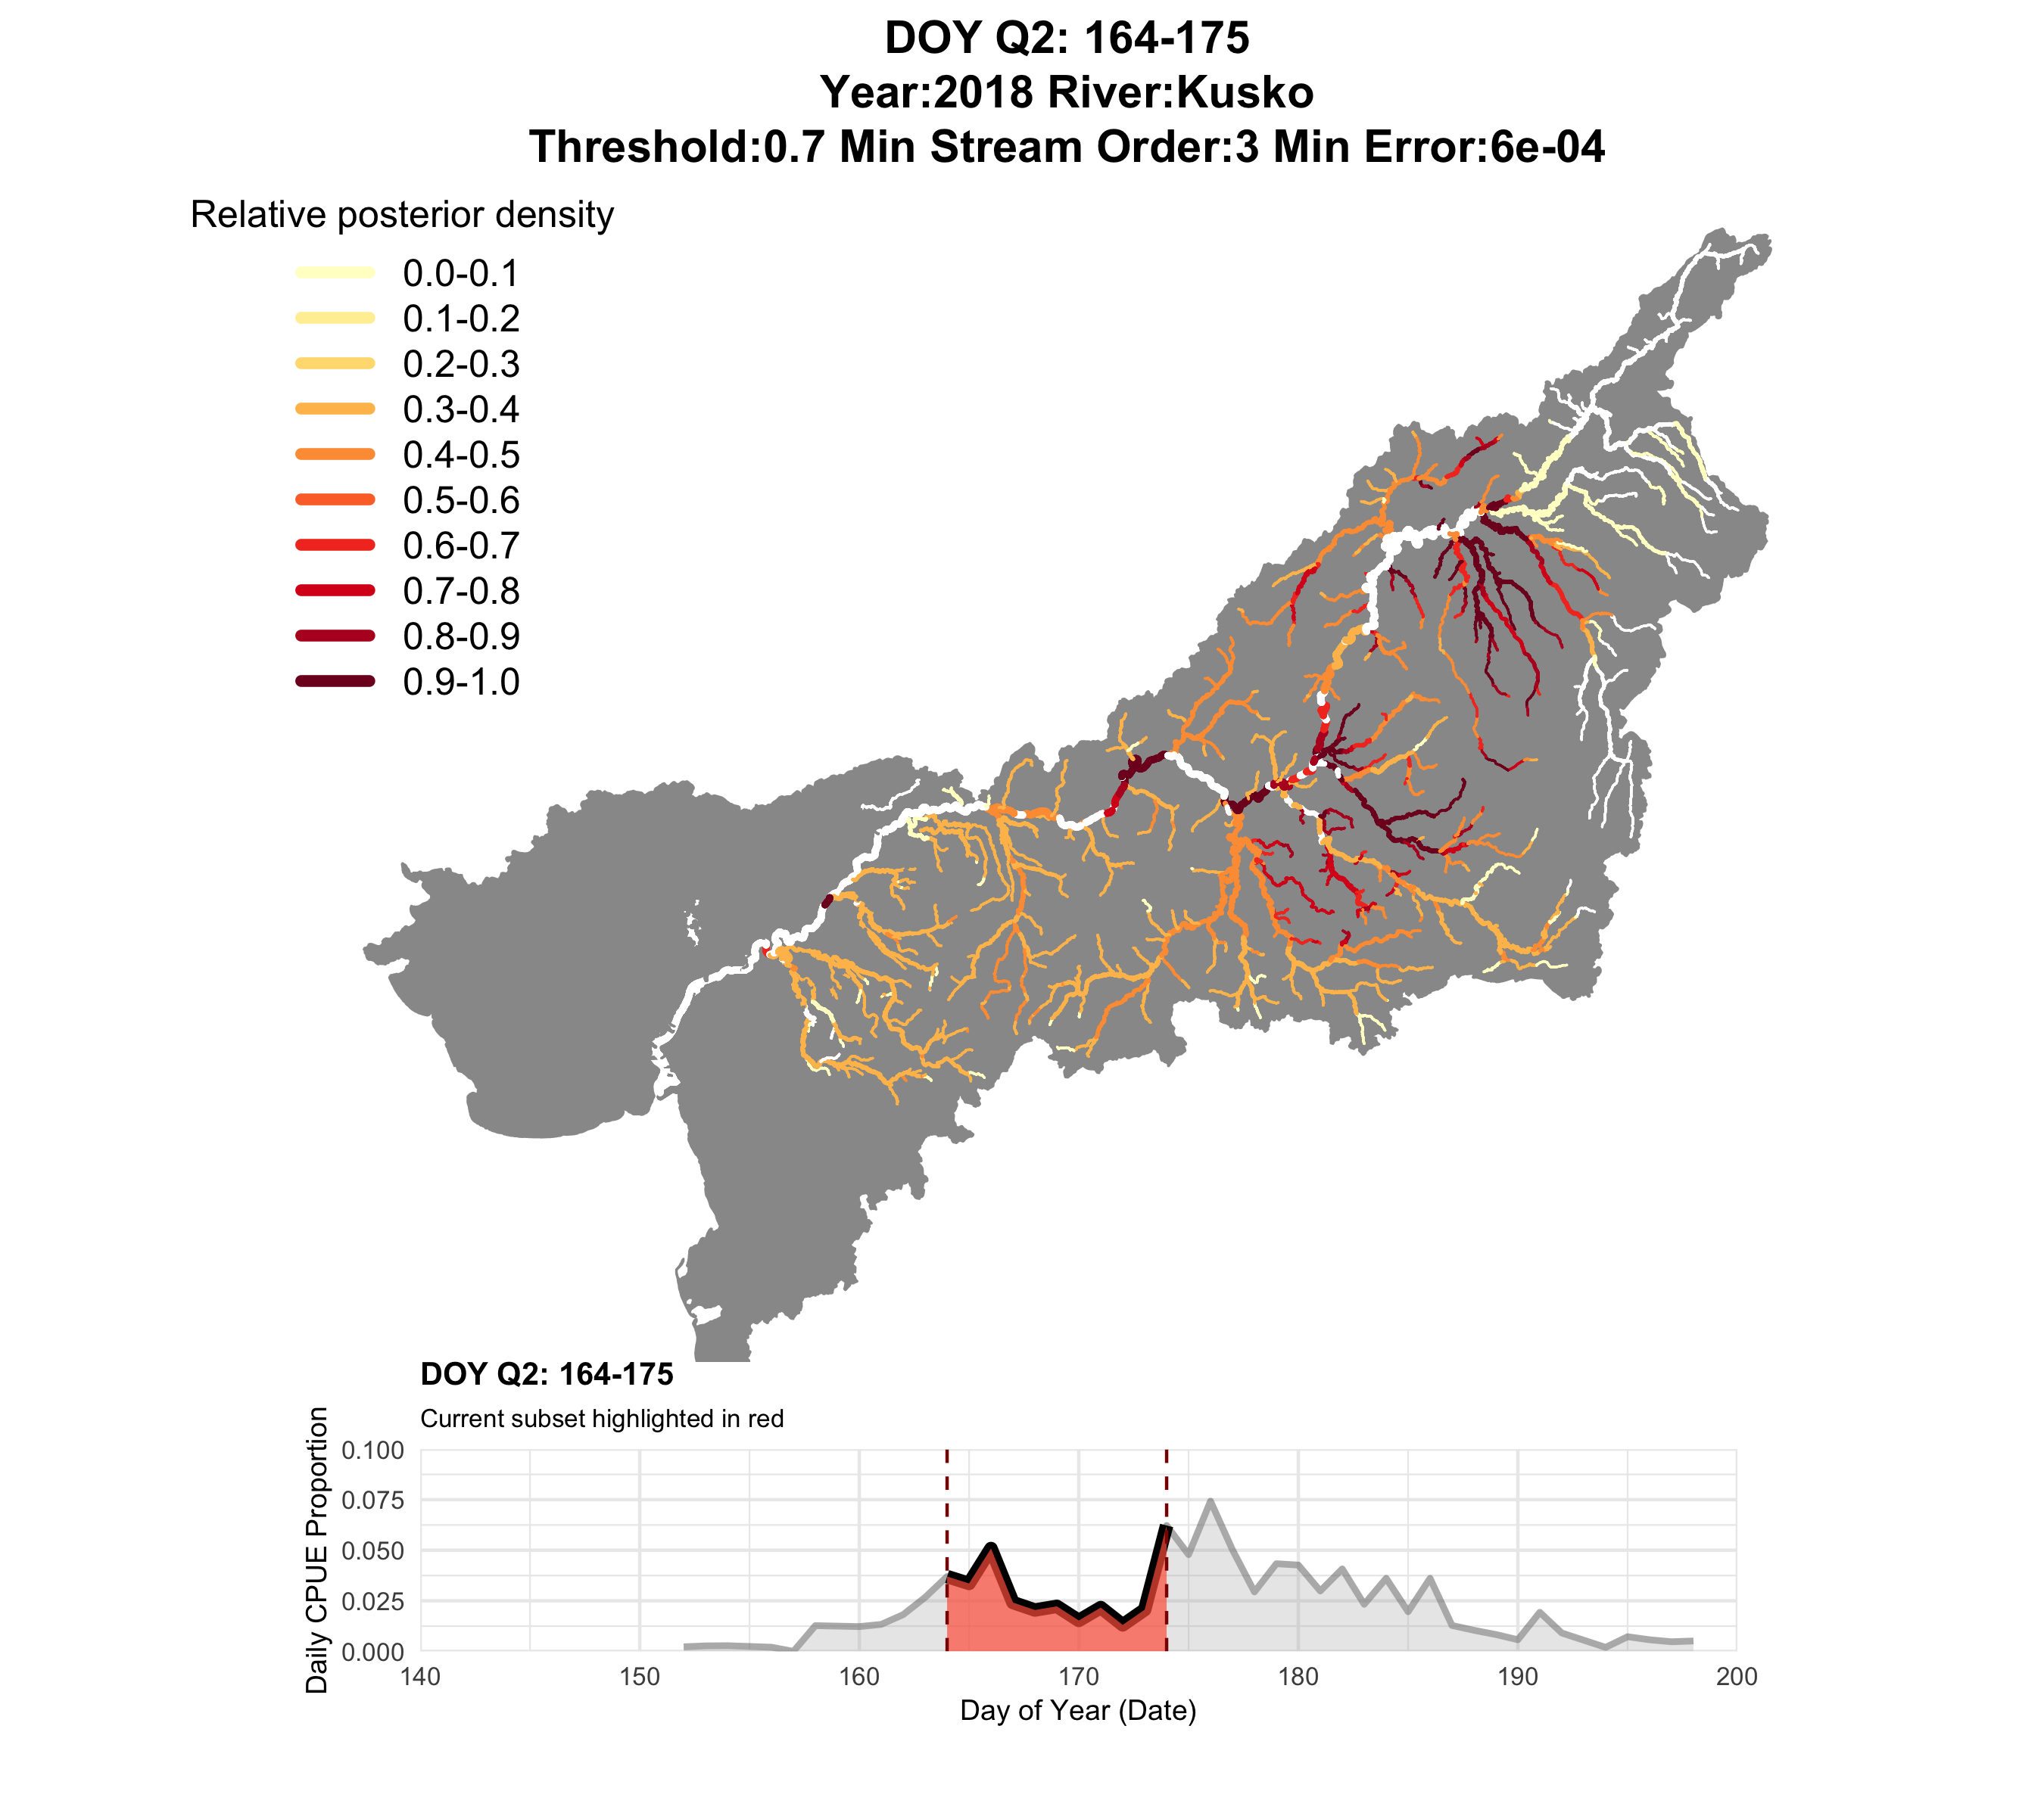
2018
Q2

Slide 18
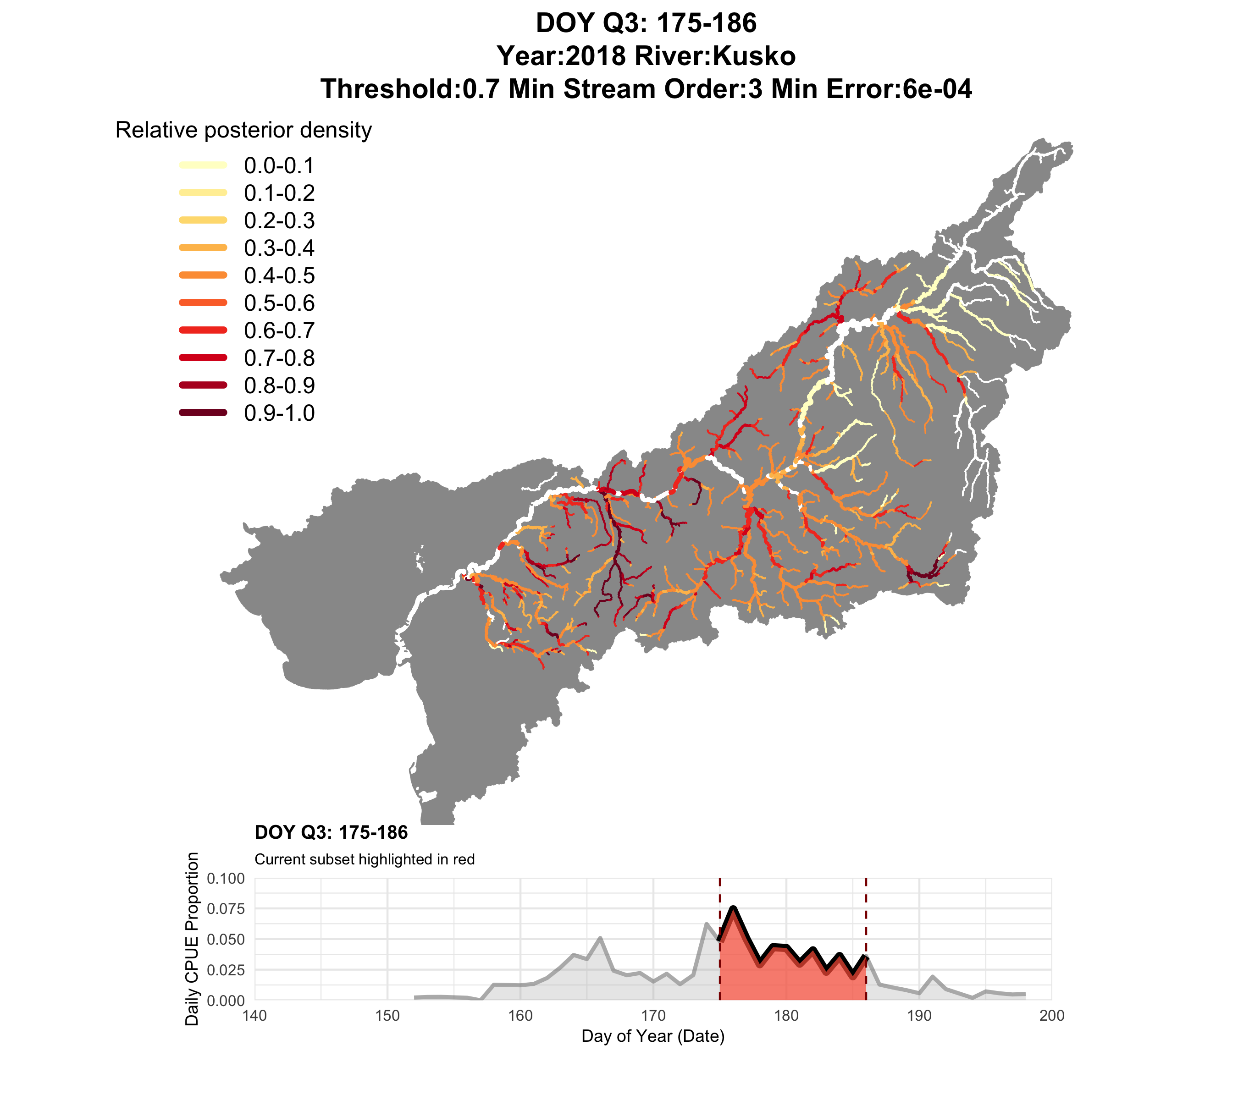
2018
Q3

Slide 19
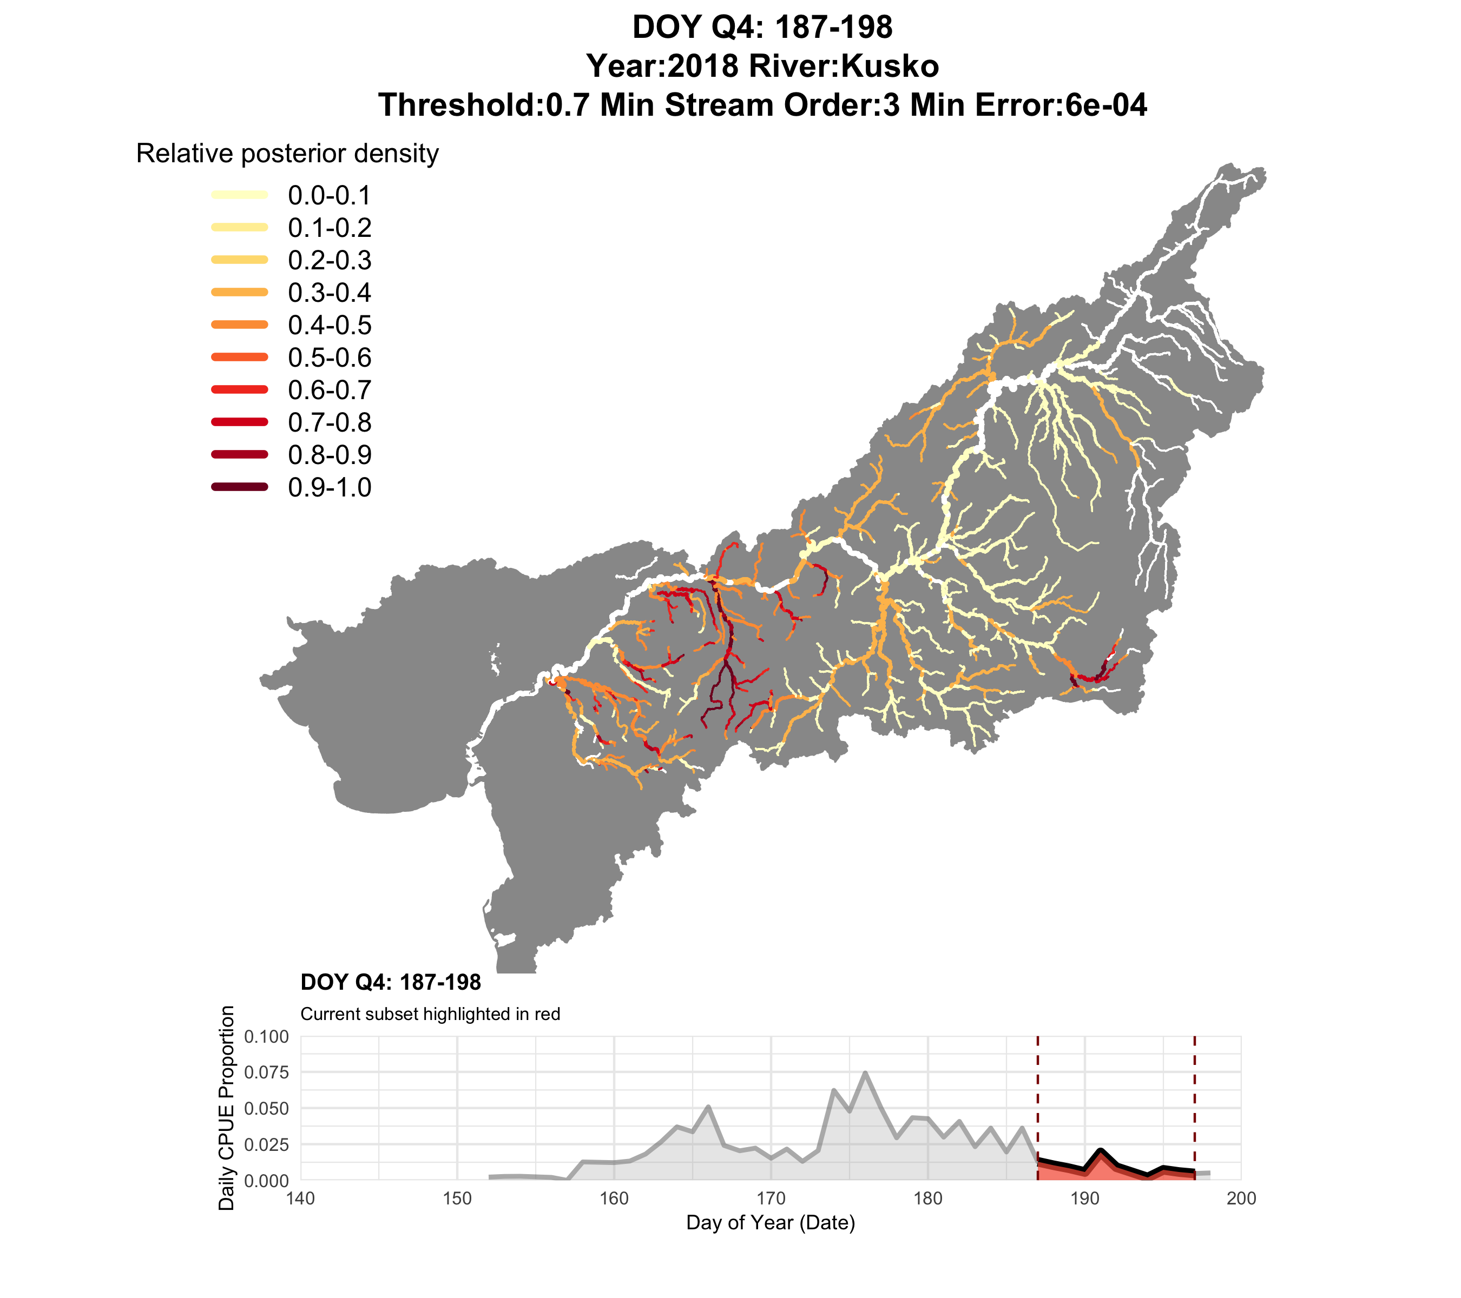
2018
Q4

Slide 20
2018
Q4
Ecologically interesting, but too fine of a spatial scale for management…

Slide 21
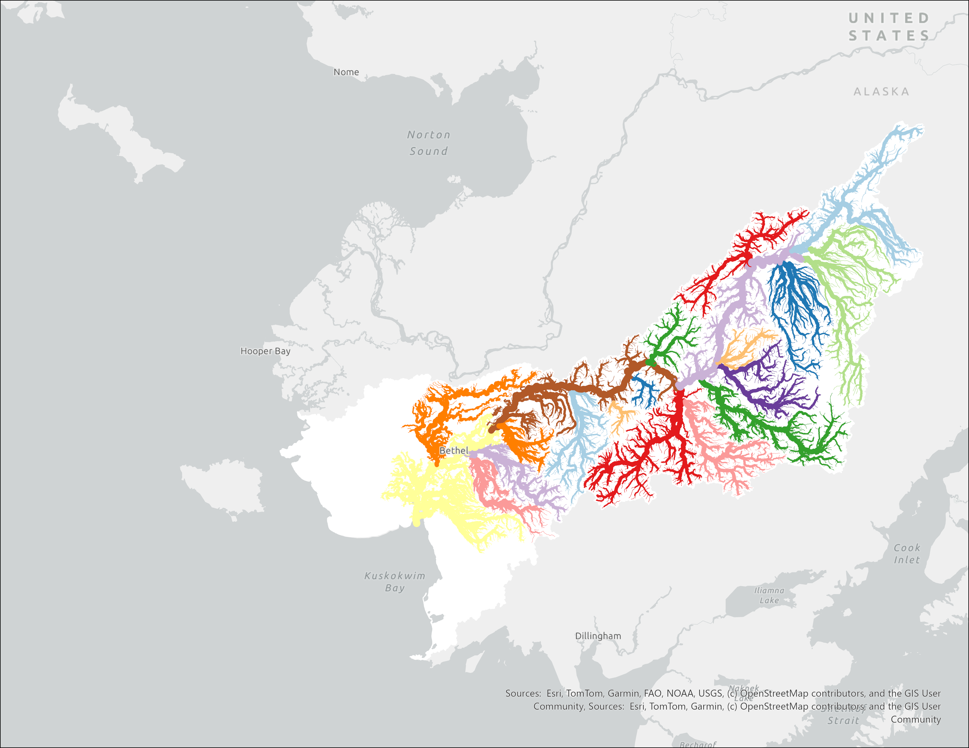
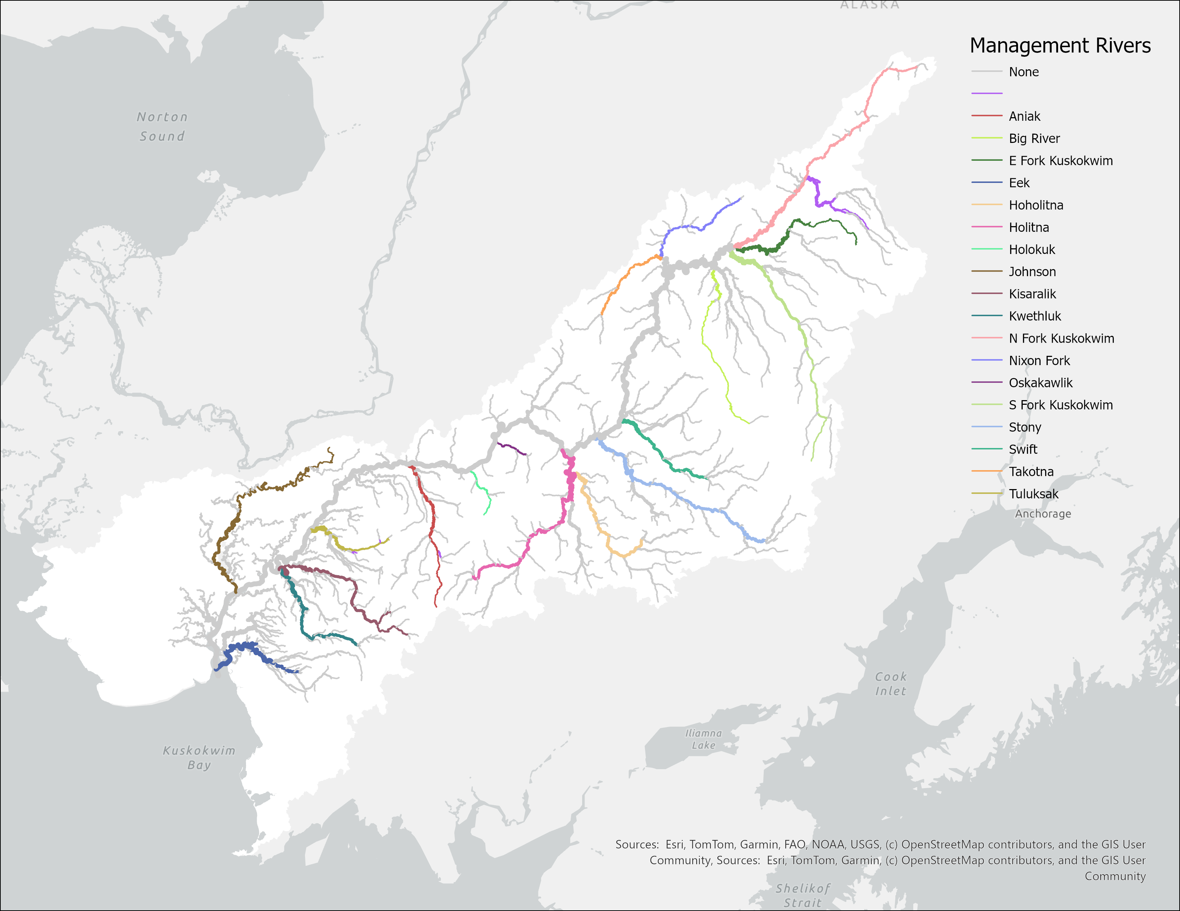

Slide 22
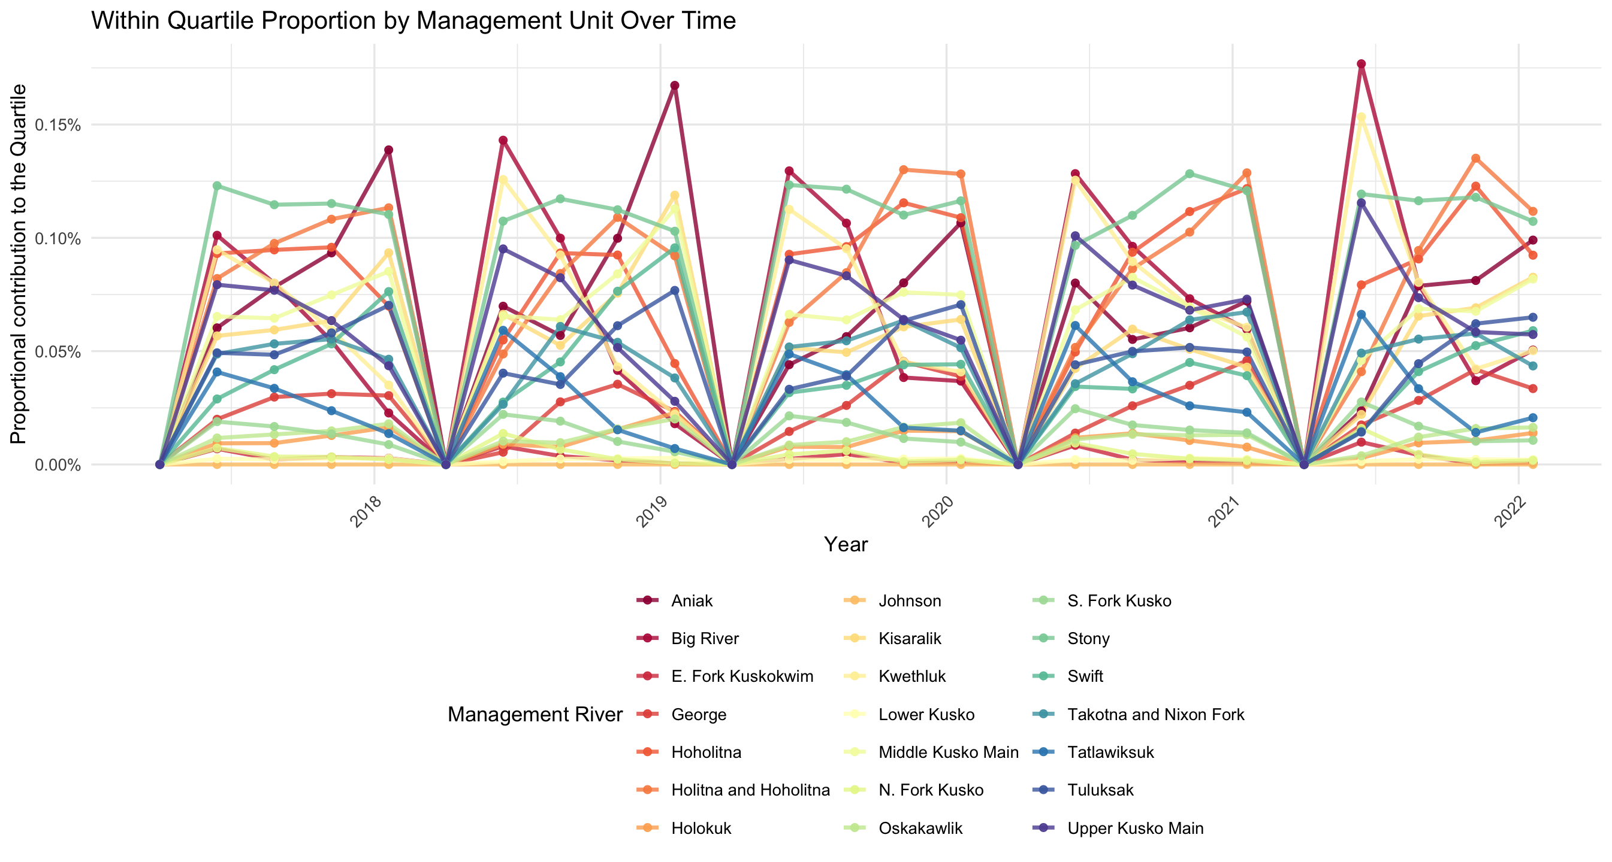
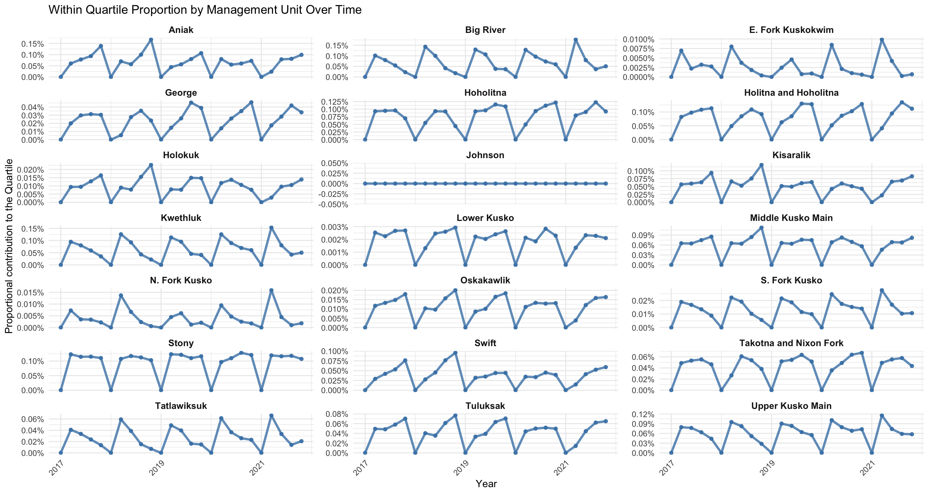
Relative contribution of each quartile

Slide 23
Relative contribution of each quartile

Slide 24
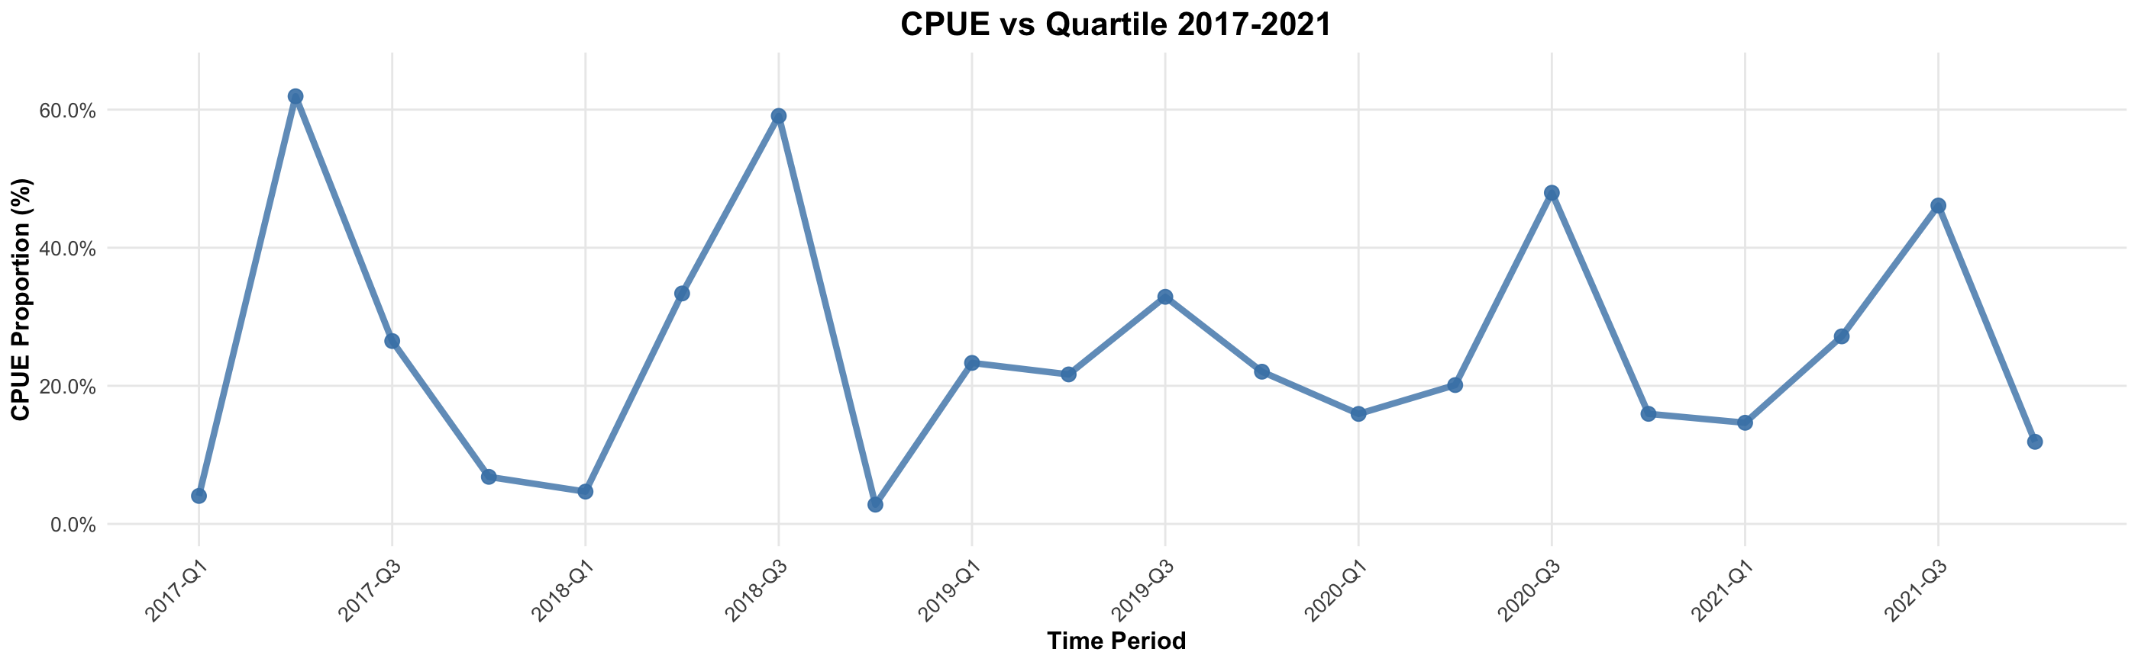
Covariates
Overall number of fish returning?
Potential covariates as hypotheses
Temporal distribution of when fish come in?

Slide 25
Dynamic Factor Analysis
Ts tool to identify common underlying trends in multivariate data.
Find shared patterns among quartiles
Test the effects of covariates on these shared patterns

Slide 26
Model Selection
m = 4 (4 Quartiles)
- tested others, but still sorting out alternative AIC…
R - “diagonal and unequal”
“diagonal and equal”
“equalvarcov”
Covariates = “CPUE, Run.Size, CPUE AND Run.Size, None”
Z matrix = * none specified*
A matrix = *none specified* , values are normalized to 0-1
U = “zero”
Although there may be trends, I don’t expect significant changes over such a short timeseries.

Slide 27
Model Selection
m = 4 (4 Quartiles)
- tested others, but still sorting out alternative AIC…
R - “diagonal and unequal”
“diagonal and equal”
“equalvarcov”
Covariates = “CPUE, Run.Size, CPUE AND Run.Size, None”
Z matrix = * none specified*
A matrix = *none specified* , values are normalized to 0-1
U = “zero”
Although there may be trends, I don’t expect significant changes over such a short timeseries.

Slide 28
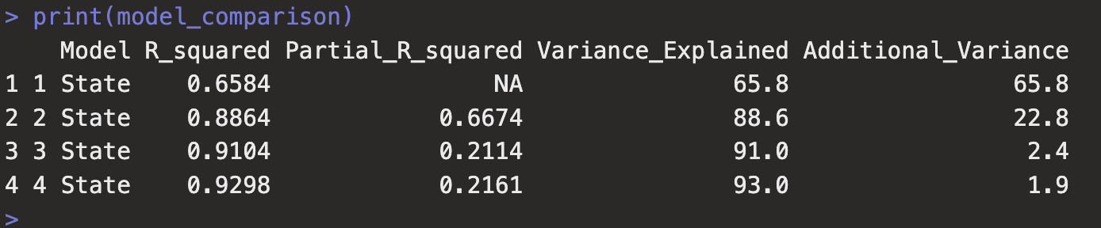
Partial R2: how much extra variance is explained by an extra trend
2 vs 3?
Lets do 3, 90% of variation

Slide 29
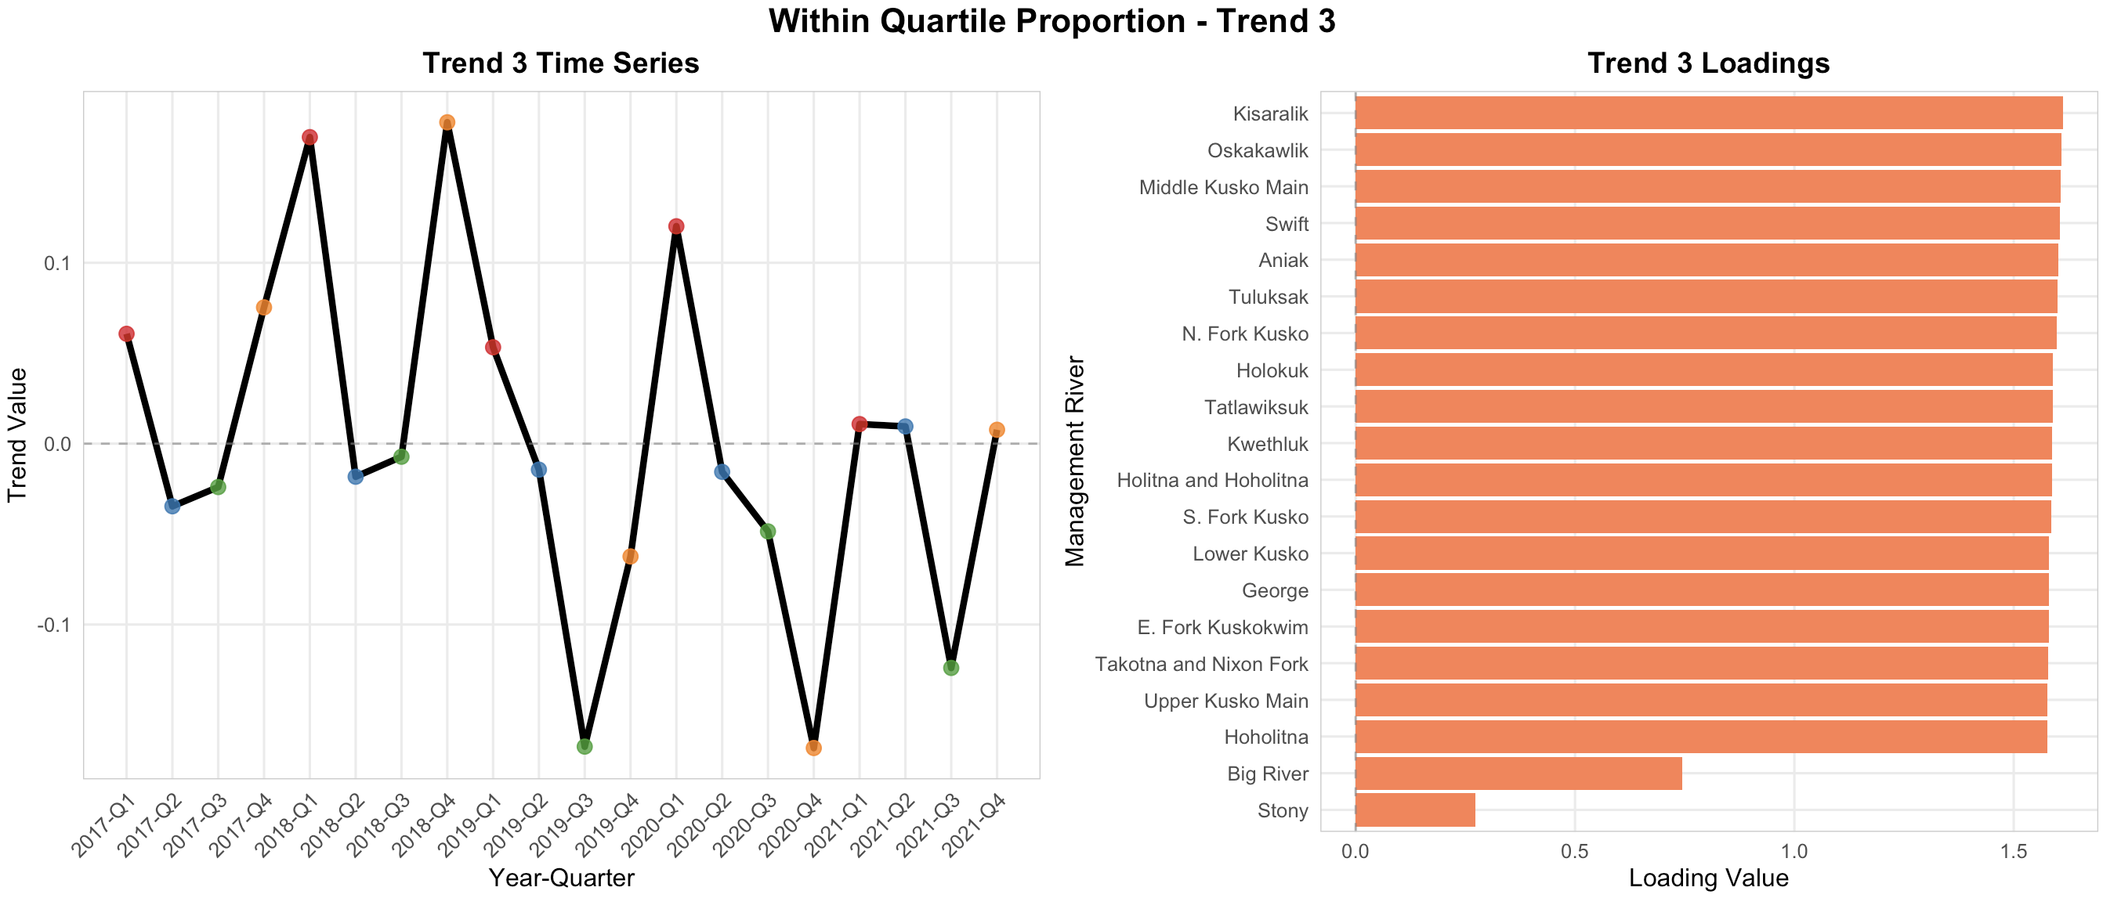
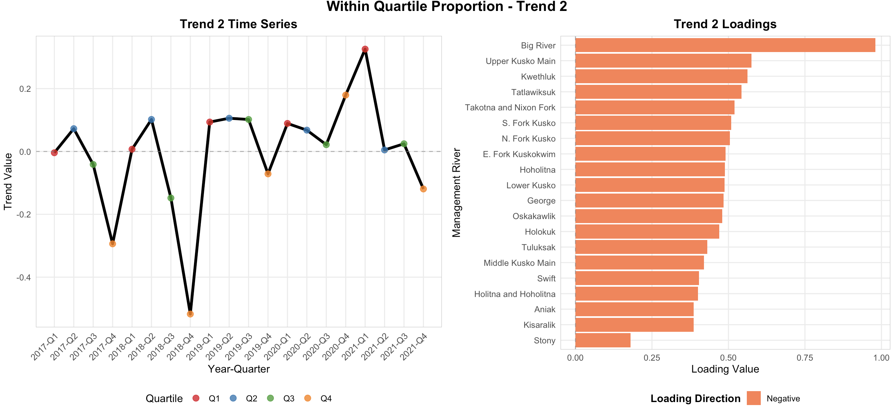

Results *After varimax rotation*

Slide 30
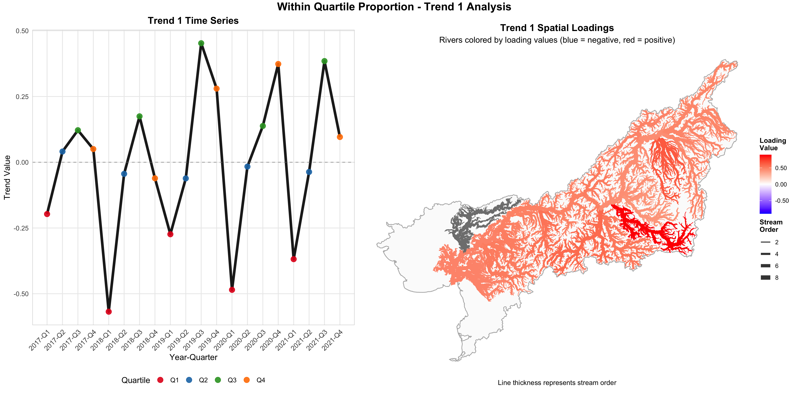
Trend 1
Increasing proportional contribution to the late run. Basically the entire basin…

Slide 31
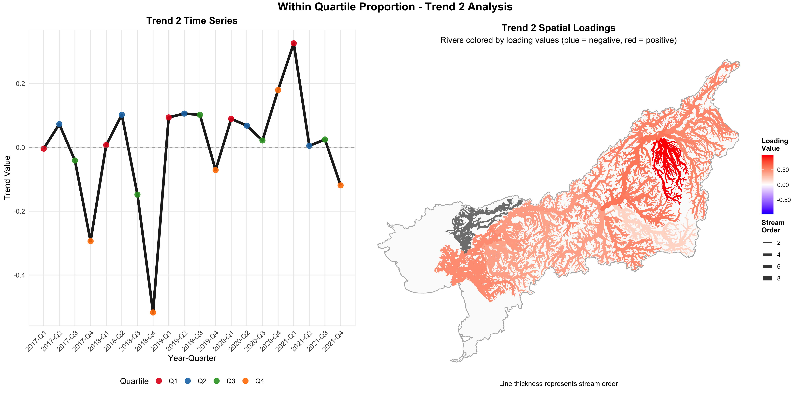
Trend 2
Previously strong proportional contribution to Q2, but now increasing and strong contribution to Q1

Slide 32
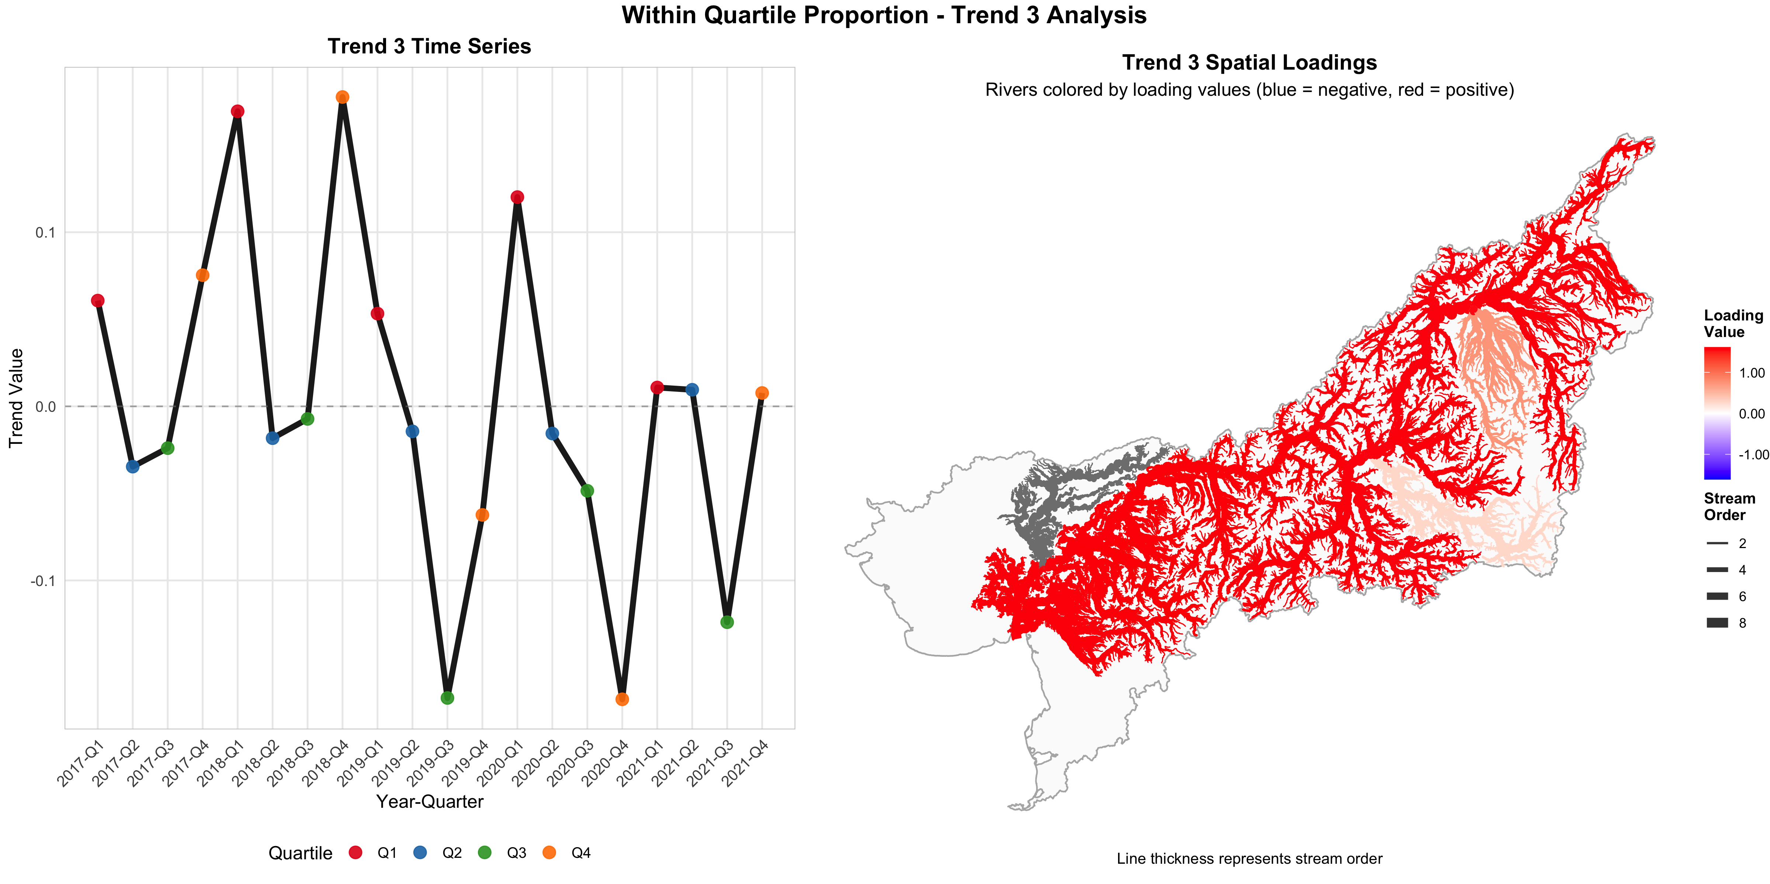
Trend 3
DECREASING mean proportional contribution

Slide 33
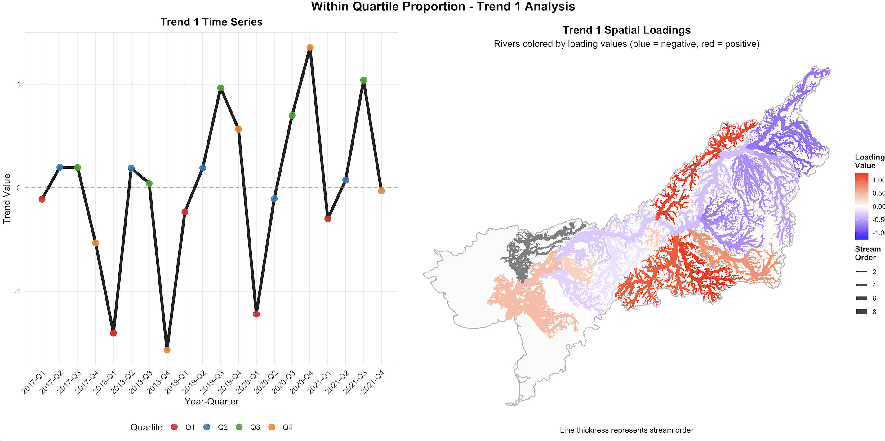
2 States!

Slide 34
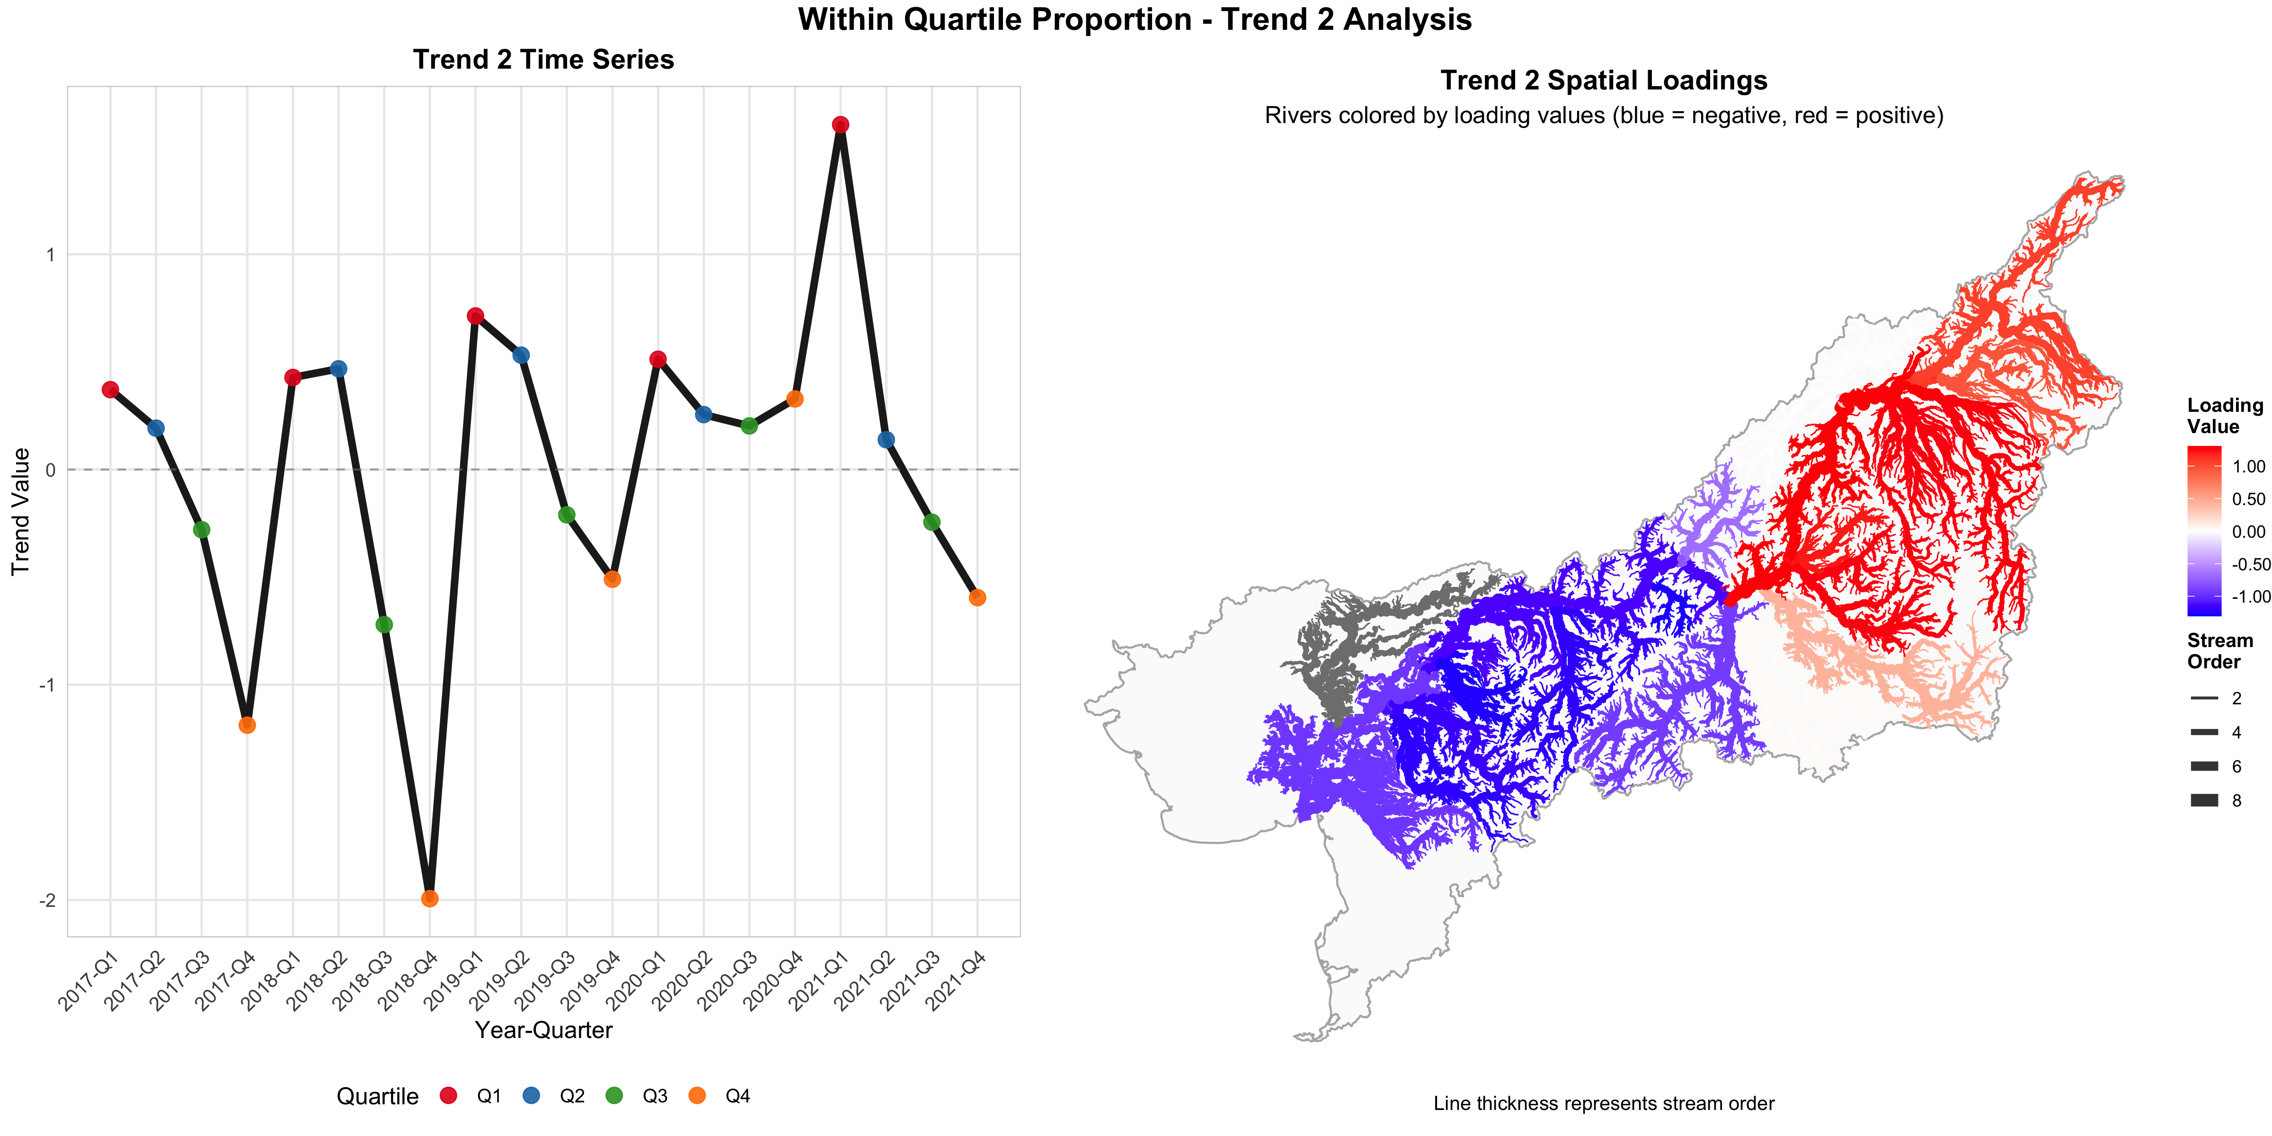

Slide 35
Future direction
-Explore other covariates?
-Translate these into proportion of the total run rather than quartile
-Also test raw #s of fish rather than proportion

Slide 36
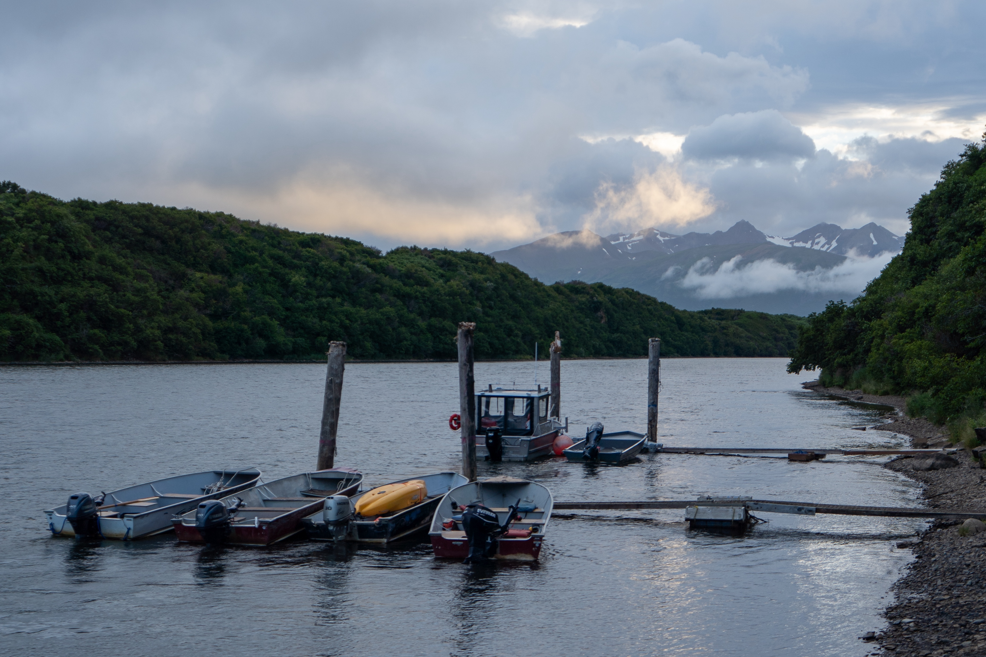
Thank you!

